Slide 1
EART 28202 : Structural Geology
Class 5 : Stress
Notes:
The development of the concept of stress in the first dozen or so slides of this class is in outline form. A more rigorous account is given in the supporting document, StressNote.pdf, that accompanies this PowerPoint presentation (I have not yet incorporated an account of 3d stress into this document – for that see Jaeger et al., p.27-41 – but you really don’t need to worry about 3d stress at 2nd year level). You do NOT need to know the contents of this document for this course. However, anyone thinking of a career / further academic study in rock mechanics or geophysics will find that a sound understanding of stress is absolutely fundamental
In the notes panes to these slides there are numerous references (figure credits and further reading). If the reference is incomplete it refers to the references stated in the reading list on the last slide
With regard to figures in this PowerPoint file, many will be subject to copyright restrictions. I don’t care about you using any of the figures/photos that are mine (Steve Covey-Crump), although a credit would be nice, but take care to comply with copyright restrictions if you reuse any that are not

Slide 2
Force
Deformation occurs when a force is applied to a body; the concept of stress is used to describe the physical state of a material body on which forces are applied. Hence, as structural geologists interested in deformation, we need to get to grips with stress
The concept of stress arises from a consideration of surface forces
There are two kinds of forces:
  body forces which act at a distance on all the volume elements of a rock (e.g., gravity, electromagnetic forces)
  surface forces which arise directly from the action of one body on another across the surface between them (e.g., when we push a block we apply a surface force across the area of contact between our hand and the block), or which arise indirectly from the action of one part of a body on another part across some imaginary internal surface – they describe the interatomic forces exerted by the material on one side of the imaginary surface upon the material on the other side
The magnitude of a body force is directly proportional to mass or volume; the magnitude of a surface force is directly proportional to the area of surface over which it acts

Slide 3
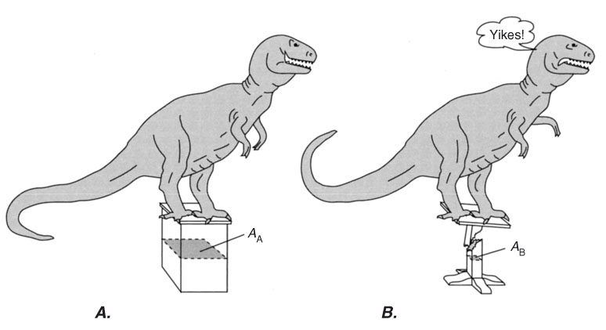
Traction
A large force obviously has a greater effect on an object than a small force. However, the response of the object is governed by the intensity of the force, not by its magnitude
The starting point for considering stress is therefore traction
Traction (T) is force intensity and is defined as
T = F/A
force
area over which
the force acts
The SI unit of force is the Newton (N) - the force required to accelerate 1 kg at 1 ms⁻²
Hence the SI unit of traction is N/m² which is known as a Pascal (1 Pa = 1 Nm⁻²)
The Pascal is a small quantity – we commonly work in megaPascals (MPa),
where 1 MPa = 10⁶ Pa (NB. 1 kbar = 100 MPa)
Notes:
Strictly, traction is defined as the limit of the ratio F/A as we shrink A to zero, that is, as we shrink the surface over which the force acts to a point. A particularly clear exposition of the concept of traction is given by Pollard & Fletcher (p.197-200) but also see the file StressNote.pdf that accompanies this PowerPoint presentation
Note that the definition of the unit of force follows from Newton’s 2nd law, F = ma (1 N = 1 kg m s⁻²). Hence in base SI units (the relevant base units are here, kg, m, s), 1 Pa = 1 N/m² = 1 kg m s⁻²/m² = 1 kg m⁻¹ s⁻²
In igneous and metamorphic petrology, you will have met the pressure unit, kilobar. 1 kbar = 100 MPa. You will find it very convenient to remember this conversion
Figure (from Twiss & Moores, p.153) illustrating the fact that it is the intensity of the force that counts, not its magnitude – note that in each case the same force acts (the weight of the dinosaur does not change) but the response of the stand is different

Slide 4
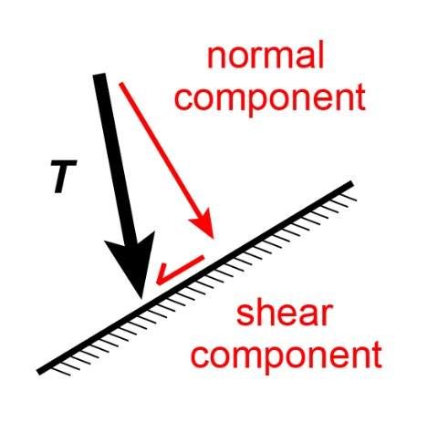
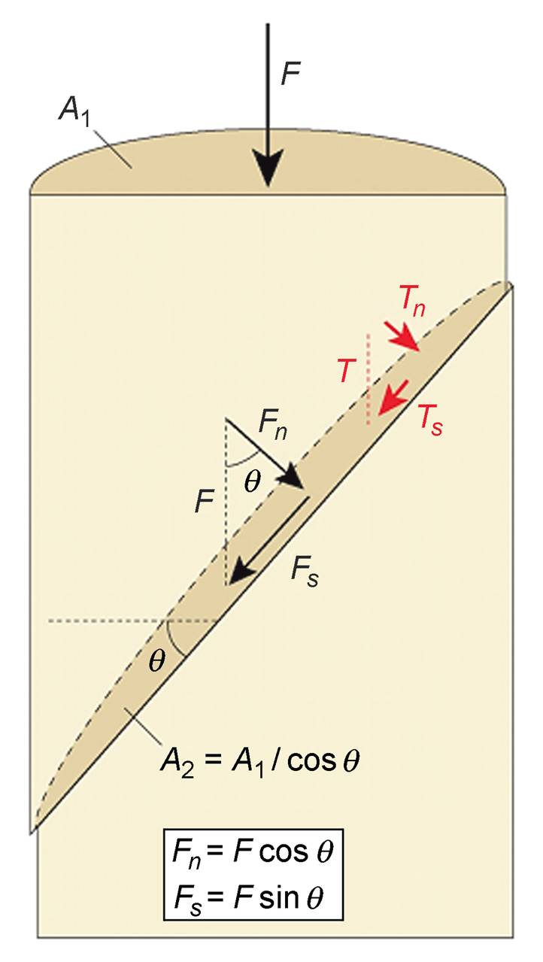
The traction vector
The traction acting on a surface within a loaded body is a vector that may be obtained by adding components acting normal and parallel to the surface
θ
T_{n} = F_{n} / A₂
= ( F cos θ ) / A₂
= ( F / A₁ ) cos² θ
T_{s} = F_{s} / A₂
= ( F sin θ ) / ( A₁ / cos θ )
= ( F / A₁ ) sin θ cos θ
= ( F / A₁ ) ( sin 2θ ) / 2
θ is the angle between the direction of the applied force and the normal to the surface (anticlockwise = positive)
Hence the magnitude and orientation of the traction vector as obtained by combining T_{n} and T_{s} varies with the orientation (θ ) of the surface
Notes:
Note the difference between resolving the force vector into normal and shear components (F_{n} = F cos θ ; F_{s} = F sin θ respectively), and obtaining the traction vector from its normal and shear components (T_{n} = T cos² θ ; T_{s} = (T sin 2θ)/2 respectively). From the perspective of the trigonometrical analysis presented on this slide, the difference arises because the traction vector depends upon the size of the area (A₂) across which the traction acts, and this depends upon the orientation (θ) of the surface. For a formal derivation of this same result, which accommodates the definition of traction as the limit of the ratio F/A as we shrink A to zero (see notes to last slide), see Pollard & Fletcher, p.203-205
Figure top middle by Steve Covey-Crump. Note that, in general, the traction vector is not parallel to the force vector
Figure right adapted by Steve Covey-Crump from Fossen, p.76

Slide 5
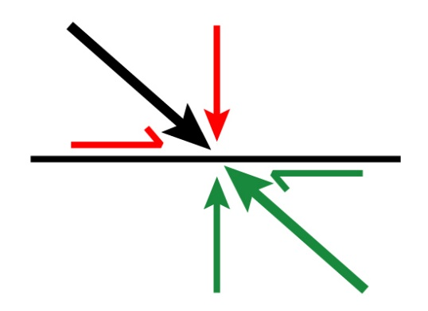
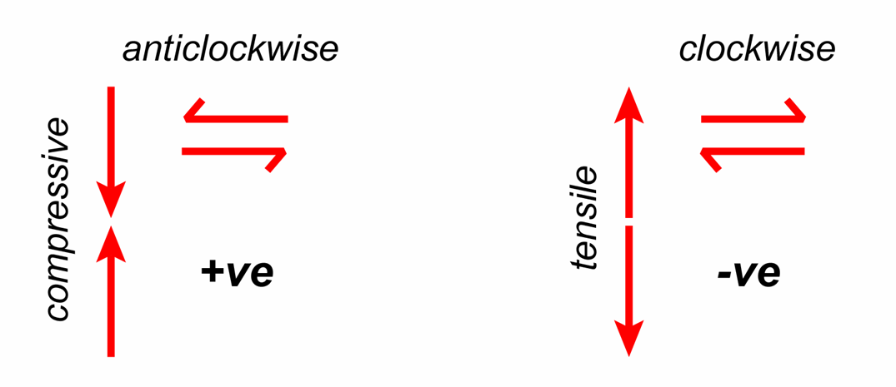
Sign conventions ; tractions → stresses
If the surface upon which a traction is applied is to be in mechanical equilibrium, then by Newton’s 3rd law there must be an equal and opposite traction operating on the other side
Positive tractions are defined as compressive and with an anticlockwise sense of shear
(Mohr circle convention)
NB. the definition of compressive tractions as positive is a geological (rock mechanics) convention; in the engineering community, compressive tractions are negative
Traction describes force intensity at a point on a surface of specified orientation;
The state of stress describes force intensity on surfaces of all possible orientations through the point
Notes:
Newton’s 3rd law: to every action there is always opposed an equal reaction
The words “Mohr circle convention” are included because in the matrix (tensor) notation of stress the sign of the shear stresses is defined in a different way (see Slides 7 and 12)
Some care is needed with using ‘anticlockwise ‘ and ‘clockwise to define +ve and -ve shear respectively because whether a rotation is clockwise or anticlockwise depends upon the direction of observation. See for yourself – if you rotate a piece of paper clockwise and then continue to do so while looking at the piece of paper from the other side, you’ll see that it is now rotating anticlockwise. Anticlockwise +ve is true if the x-axis points right and the y-axis points up (the conventional orientations of these axes when we plot a graph) because then according to the right-hand rule we are looking in the -ve z-direction – with your right hand put your thumb pointing right along the x axis and your first finger pointing up along the y axis; your second finger (z axis) is now pointing towards you; now put your thumb pointing along the z axis towards you and you will see that your fingers curl in an anticlockwise sense, that is, anticlockwise is +ve. However, clockwise rotations are +ve when we look in a +ve axis direction (with your right-hand thumb pointing that way, your fingers curl in a clockwise sense). If we were to define our axes so that x pointed left and y pointed up, then anticlockwise would be -ve. You’ll not go wrong in this course unit if you simply remember anticlockwise = +ve (as it was when we considered shear strain, Class 3 Slide 4)
The geological convention of positive compressive stresses follows from the fact that stresses within the Earth are dominantly compressive. Engineers prefer to consider tensile stresses as positive because they are concerned with the failure of engineering constructions – the tensile strength of materials is generally smaller than the compressive strength and is therefore of greater significance to them. In both cases, the definition is designed to avoid unnecessary numbers of negative signs in the various deformation modelling equations
Note that if we are being strict in terminology, in stress we have compression and tension, while in strain shortening is contraction and lengthening is extension. Note also that extension can occur even when all stresses are compressive – the deformation response depends upon the relative magnitudes of the stresses in different directions and so if we compress strongly in one direction, extension will occur in directions at a high angle to this provided that the compressive stresses acting in those directions are relatively small
Figures by Steve Covey-Crump

Slide 6
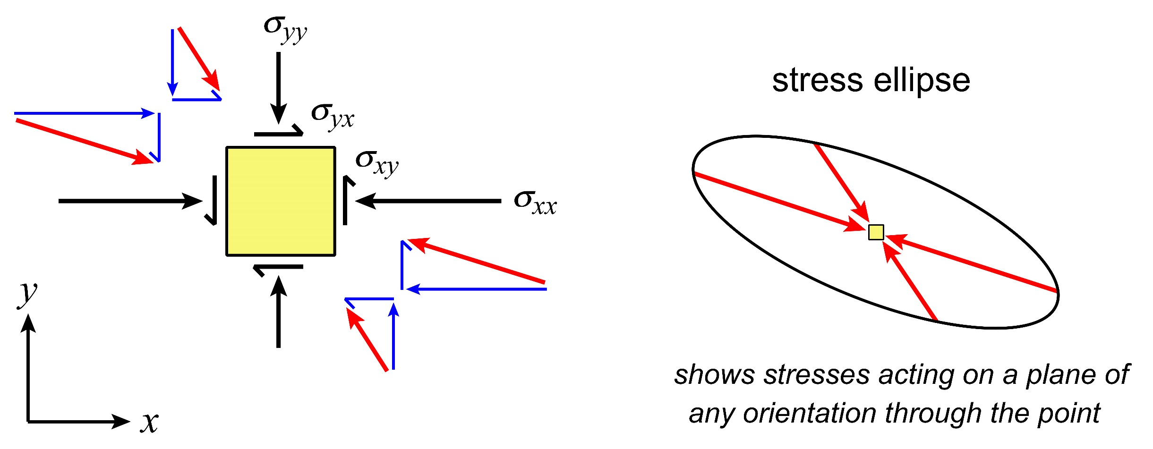
Stress at a point in 2D
In 2D, if we calculate the traction acting on planes of all possible orientations through a point, the tails of the traction vectors define an ellipse (stress ellipse)
The state of stress, σ , is therefore given by the information that is required to define the shape and orientation of this ellipse → this is given by knowledge of the tractions acting on two mutually perpendicular surfaces
Hence the state of stress is defined by four numbers:
two normal stresses, σ_{n} = σ_{xx} , σ_{yy}
two shear stresses, τ = σ_{xy} , σ_{yx}
σ_{xy}
pole to
plane
direction
Notes:
The 2D analysis applies for biaxial compression (or tension), that is, when the body (the yellow square in the figure on the slide) is being compressed in two perpendicular directions. Note that this method of defining the stress ellipse requires that all tractions be either positive or negative and not some combination of these
In general, the traction vector is not at right angles to the surface upon which it is acting. This means that given a particular traction vector, the orientation of the surface on which it is acting is not immediately obvious (notice on the figure on this slide how the orientations of the surfaces of the yellow square upon which the red traction arrows are acting are not obvious from the orientations of the red arrows themselves). A simple construction allowing the surface orientation to be obtained from the traction vector using the stress ellipse is described by Ragan (p.226)
There are two surfaces (at right angles to each other) for which the traction vector is parallel to the pole (normal) to the surface – the traction vector then has zero shear component and so equals the normal component. These two orientations correspond with the maximum and minimum values of the magnitude of the traction vector, that is, with the two axes of the stress ellipse (the significance of this point is developed in Slide 8). Hence it follows that the stress ellipse may be defined by plotting the normal component of traction acting on planes of all possible orientations through a point (for the analysis behind this approach to defining the 2D stress ellipse, see Price & Cosgrove, p.6-7)
The conventional symbol for stress is σ. In the subscript to these stresses the first letter refers to the direction of the normal to the surface and the second letter to the direction in which the stress component of interest is acting. When the stress on one specific surface is being considered, the normal stress (= normal component of traction on that surface) is commonly written as σ_{n} and the shear stress (= shear component of traction on that surface) as τ
Figure by Steve Covey-Crump based on Twiss & Moores, p.152. The red arrows are the traction vectors; the blue arrows are the normal and shear components of the traction vector on the indicated surfaces

Slide 7
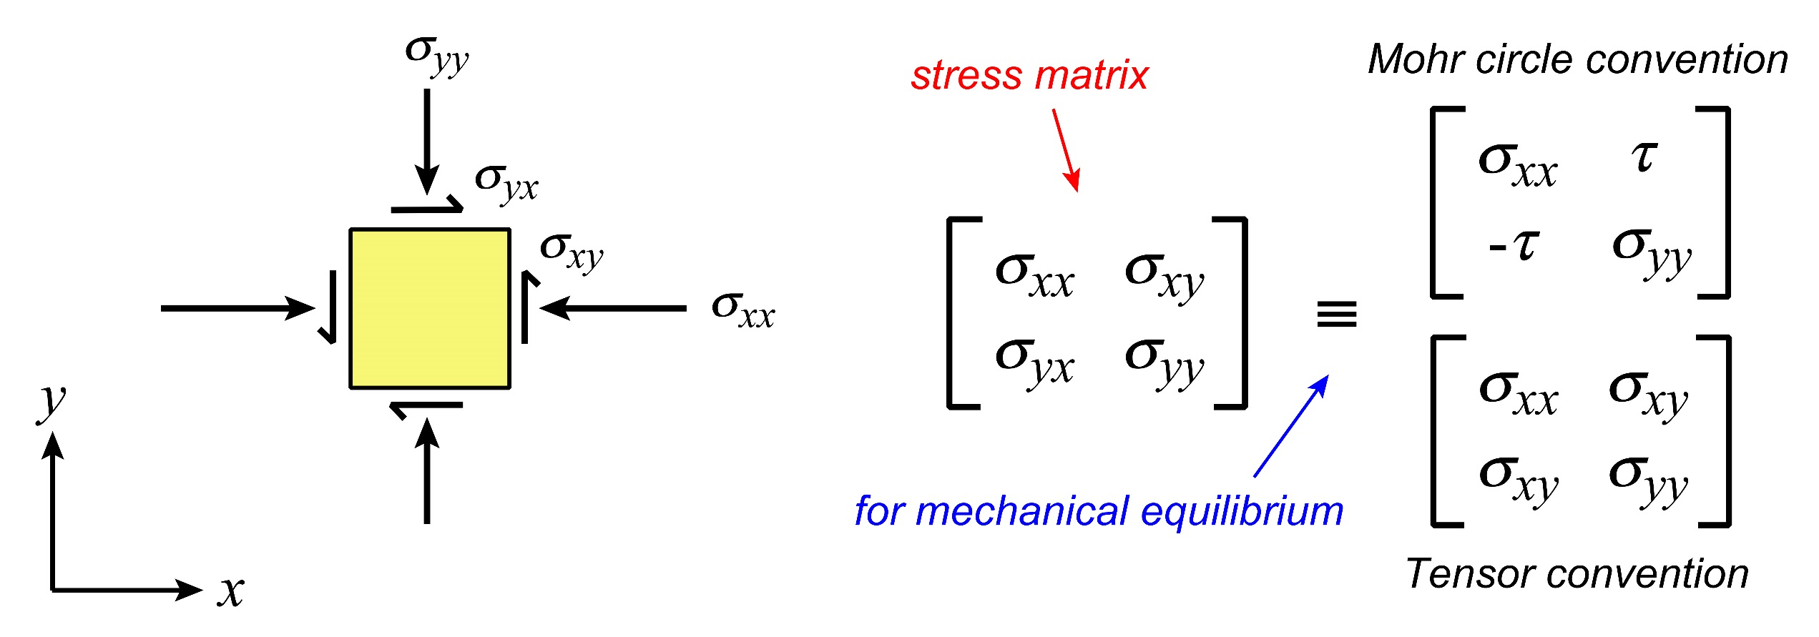
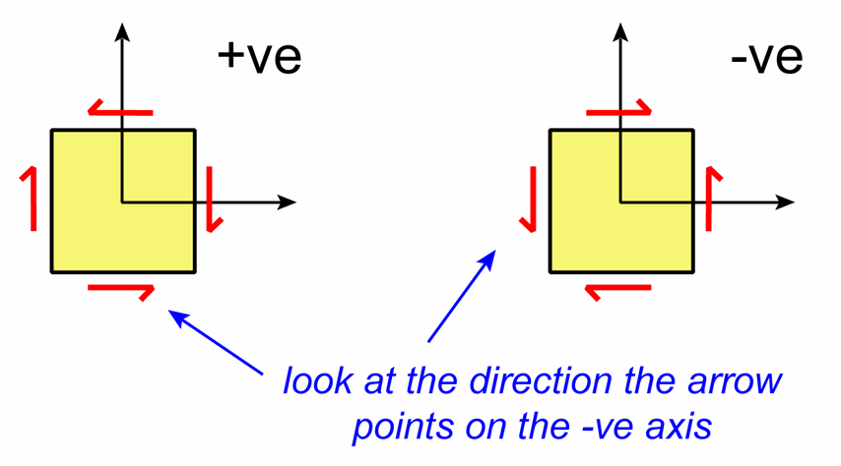
The 2D stress matrix
The four numbers defining the state of stress in 2D may be written as a 2×2 matrix
For mechanical equilibrium, σ_{xy} = - σ_{yx}
To eliminate the minus sign so that σ_{xy} = σ_{yx} , it is convenient when working with the stress matrix to use a different sign convention for shear stresses: shear stresses are positive if
the shear sense on the sides of the square that cut the negative coordinate axes are in a positive direction (tensor convention)
Notes:
For those of you who are unfamiliar with matrices, note that the terms in each row have the same first subscript and the terms in each column have the same second subscript
The leading diagonal of the matrix contains the normal stresses, and the off-diagonal terms are the shear stresses
In this case, the conditions for mechanical equilibrium are the conditions required to stop the yellow square from spinning. For this to be so, the two shear stress terms must be equal and opposite
The tensor convention for assigning the signs of the shear stresses makes the stress matrix symmetric which is mathematically very convenient. The tensor convention also works for the signs of the normal stresses – note that for the stress state on the top diagram on this slide, the stresses are compressive and if we look at the direction that the normal stress arrows are pointing on the negative faces of the square, we see that they are pointing in a +ve direction
Looking at the faces of the square that cut the -ve axes works in rock mechanics where compressive stresses are +ve. In the engineering sciences, where compressive stresses are -ve (see Slide 5), the signs of the normal and shear stresses are assigned by looking at the faces of the square that cut the +ve axes. The practical class handout illustrates this
“Tensor convention” refers to the fact that stress is a tensor quantity (see Slide 13)
Figures by Steve Covey-Crump – note how the shear stresses on the square in the top figure are both negative in the tensor convention, whereas in the Mohr circle convention the pair acting horizontally are negative (they act to spin the box clockwise) and the pair acting vertically are positive (they act to spin the box anticlockwise)

Slide 8
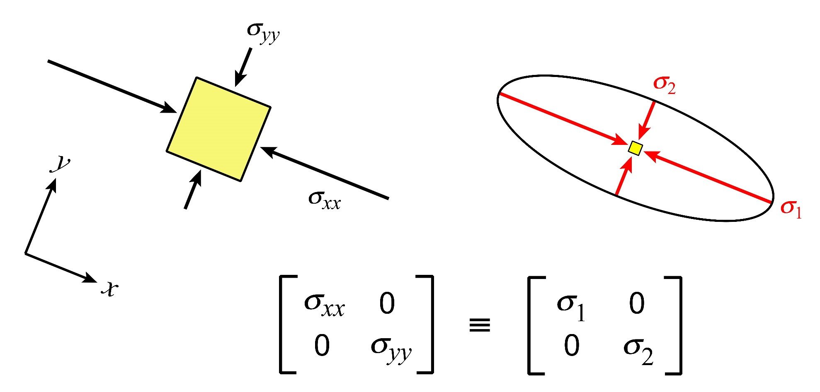
Principal stresses
It is always possible to choose an orientation of the coordinate axes such that the shear stresses are zero parallel to these axes
In this orientation the normal stresses parallel to the coordinate axes are described as principal stresses, σ₁ and σ₂, where by convention, σ₁ ≥ σ₂
The greatest principal stress (σ₁ ) is the semi-major axis of the stress ellipse
The least principal stress (σ₂ ) is the semi-minor axis of the stress ellipse
Principal stresses in terms of the stresses in an arbitrary frame
σ₁, σ₂ = ½ (σ_{xx} + σ_{yy} ) ± ½ [ (σ_{xx} - σ_{yy} )² + 4σ_{xy} ² ] ^{½}
tan 2θ = 2σ_{xy} / (σ_{xx} - σ_{yy} )
where θ is the angle measured from σ₁ to the normal to the plane
Stresses on a plane in terms of the principal stresses
σ_{n} = [ (σ₁ + σ₂ ) / 2 ] + [ (σ₁ - σ₂ ) / 2 ] cos 2θ
τ = [ (σ₁ - σ₂ ) / 2 ] sin 2θ
Notes:
Following the way that matters were presented on Slides 4-6, note that when the shear component of traction is zero, the traction vector is acting parallel to the pole to the surface. Surfaces on which this is so are described as principal planes of stress
The derivation of the two sets of equations on the bottom right of this slide is given in the document accompanying this PowerPoint presentation (StressNote.pdf). The first pair of equations is helpful when we know σ_{xx}, σ_{yy}, and σ_{xy} and want to calculate the principal stresses; the second pair of equations is helpful when we want to go the other way
Figure by Steve Covey-Crump

Slide 9
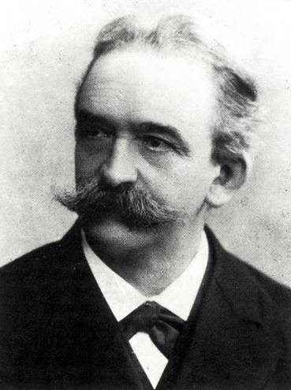
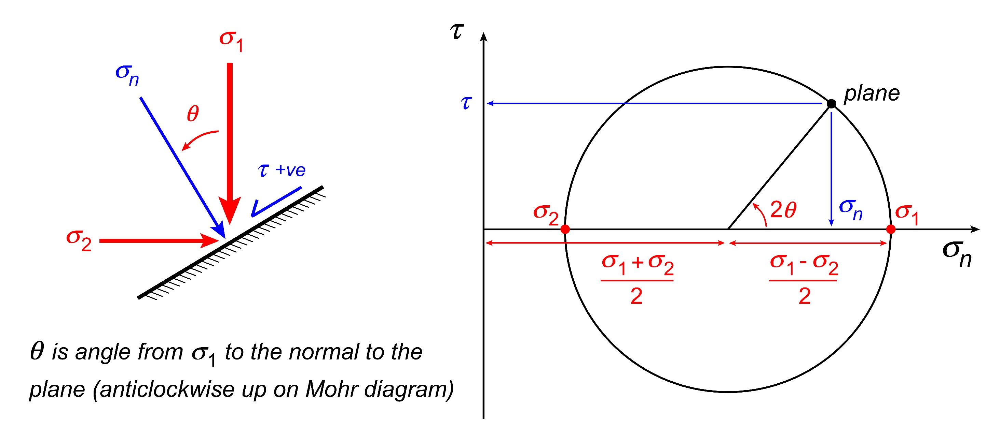
Mohr circle representation of stress (in 2D)
σ_{n} = ½ (σ₁ + σ₂) + ½ (σ₁ - σ₂) cos 2θ
τ = ½ (σ₁ - σ₂) sin 2θ
have the same form as the parametric equations for a circle and so there is a straightforward graphical approach that allows the stresses on a plane of any orientation to be calculated. The diagram that implements this approach is known as the Mohr diagram
Notes:
The parametric equations for a circle centred on the x-axis are: x = C ± r cos ϕ and y = ± r sin ϕ where C is the centre of the circle, r is its radius, and ϕ is the angle that a radius of the circle makes with the +ve x-axis
Note the conventions: θ is the angle from σ₁ to the normal of the plane of interest and plots on the Mohr diagram as anticlockwise (+ve) up
Note that the convention for assigning signs to the shear stresses outlined on Slide 5 must be used, NOT the tensor convention
The circle on this diagram describes all possible combinations of σ_{n} and τ, that is, how σ_{n} and τ co-vary as the orientation of the plane is varied. Hence from the diagram, given σ₁ and σ₂ then σ_{n} and τ may be found for any plane of interest. Alternatively, given σ_{n} and τ on any two planes, σ₁ and σ₂ may be determined. This was very helpful in the days before calculators, and remains very helpful now if you are not comfortable with matrix manipulation
Image top right (from https://upload.wikimedia.org/wikipedia/commons/5/56/Christian_Otto_Mohr.jpg): Christian Otto Mohr (1835-1918). Otto Mohr was a German civil engineer. He presented his graphical construction in: Mohr O., 1882, Über die darstellung des spannungszustandes eines körperelements, Der Civilingenieur 28: 113-156
Figure bottom by Steve Covey-Crump

Slide 10
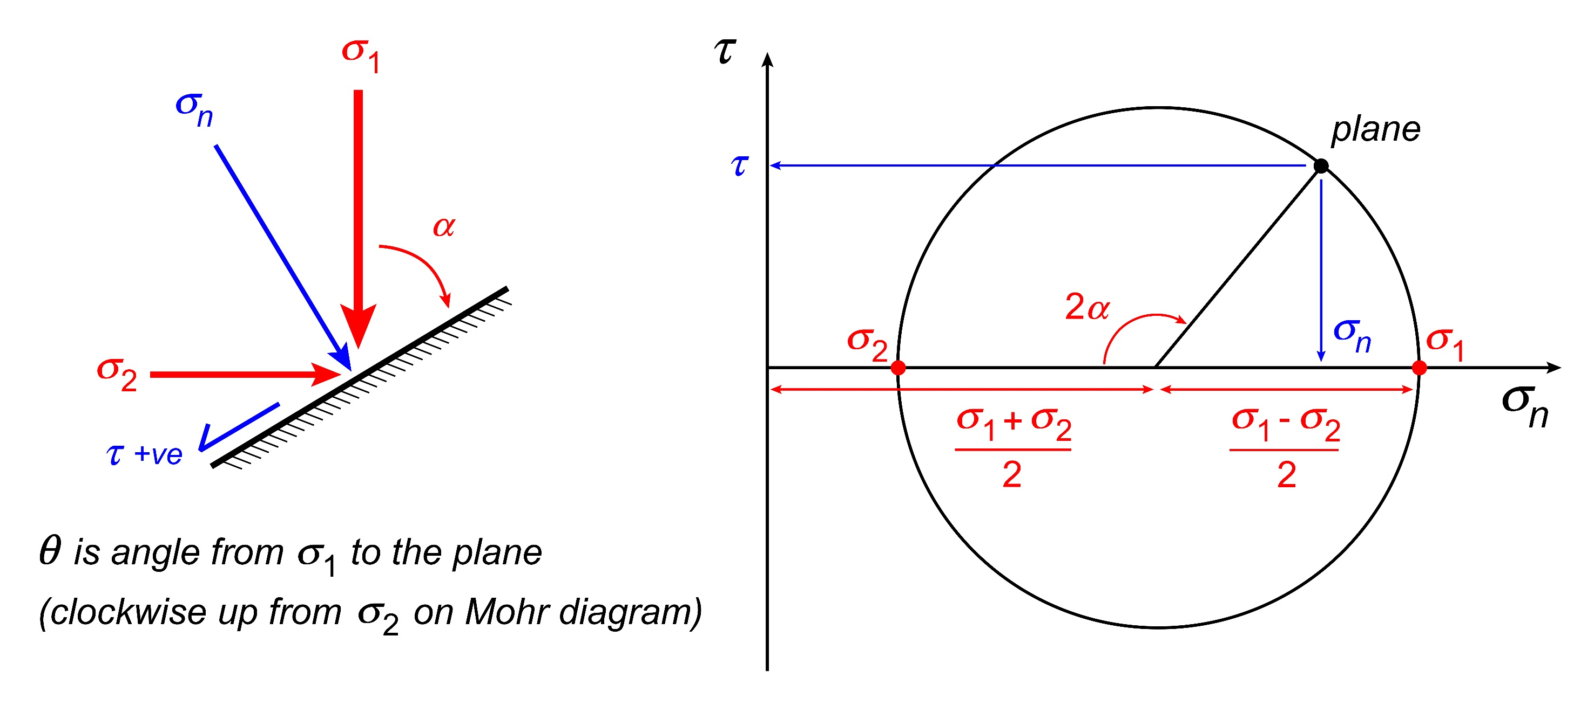
Mohr circle representation of stress (2D alternative)
Many prefer to use α, the angle between σ₁ and the plane itself (arguably more intuitive), rather than θ, the angle between σ₁ and the normal to the plane (mathematically more conventional). Below the Mohr diagram is drawn using α
Throughout this course we will use the mathematically more conventional version that was illustrated on the previous slide
Notes:
Note that α is the angle from σ₁ to the plane and so it is also the angle from σ₂ to the plane normal – hence the way that α has been depicted on the figure
It is as well to be aware of this alternative presentation of the Mohr circle diagram because it appears in many (of the older) rock mechanics’ texts
Figure by Steve Covey-Crump

Slide 11
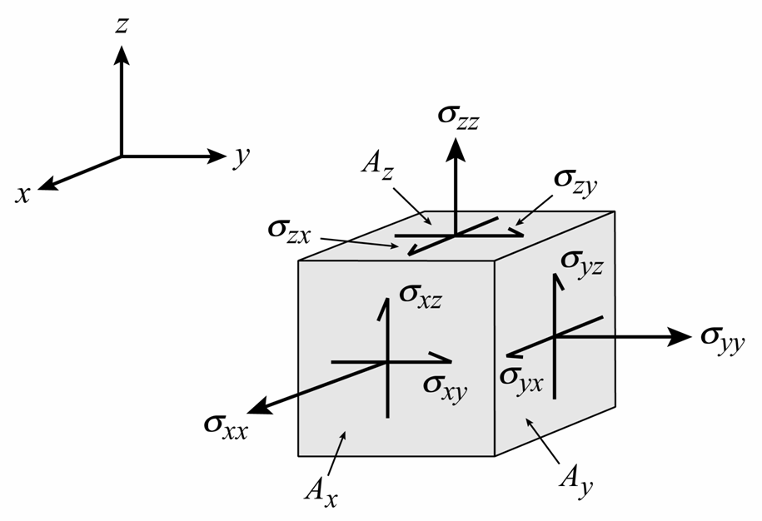
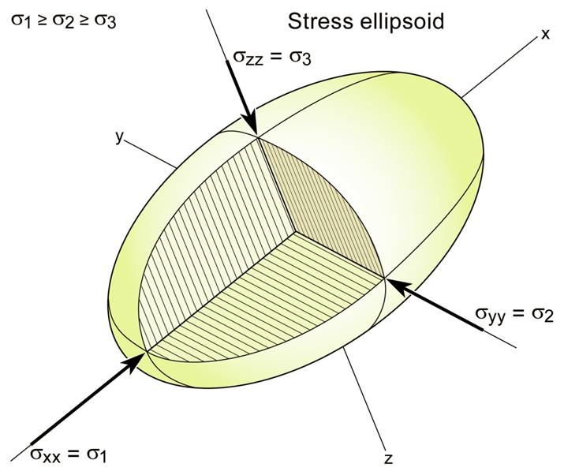
Stress at a point in 3D
In 3D the state of stress is fully defined by the stresses acting on any three mutually perpendicular surfaces
Using a Cartesian coordinate frame, the component of an applied force F acting along the x-axis is F_{x}, and gives rise to:
σ_{xx} = F_{x} / A_{x} (normal stress)
σ_{yx} = F_{x} / A_{y} (shear stress)
σ_{zx} = F_{x} / A_{z} (shear stress)
Similarly, F_{y} → σ_{yy}, σ_{xy}, σ_{zy}, and F_{z} → σ_{zz}, σ_{xz}, σ_{yz}
The stress ellipse becomes a stress ellipsoid and three principal stresses (σ₁, σ₂, σ₃ ) are defined
The state of stress at a point is defined by nine numbers but for mechanical equilibrium
σ_{xy} = - σ_{yx} ; σ_{yz} = - σ_{zy} ; σ_{xz} = - σ_{zx}
Notes:
Again (see Slide 3), strictly, the state of stress at a point is the limit of these ratios as one shrinks the areas to zero, e.g., σ_{xx} is the limit of F_{x}/A_{x} as A_{x} tends to zero
The stress ellipsoid defined in this way is sometimes called Lamé’s stress ellipsoid. The axes of the ellipsoid define the orientations and magnitudes of the three principal stresses. By convention, σ₁ is the greatest principal stress (longest axis); σ₂ is the intermediate principal stress (intermediate axis), and σ₃ is the least principal stress (shortest axis). On planes oriented with one of these principal stresses as its pole, the shear stresses are zero, that is, the traction vector equals the normal stress acting on that plane
Figure top by Steve Covey-Crump
Figure bottom from J-P Burg’s 2016 lecture notes (www.files.ethz.ch/structuralgeology/JPB/files/English/1stress.pdf), p.45

Slide 12
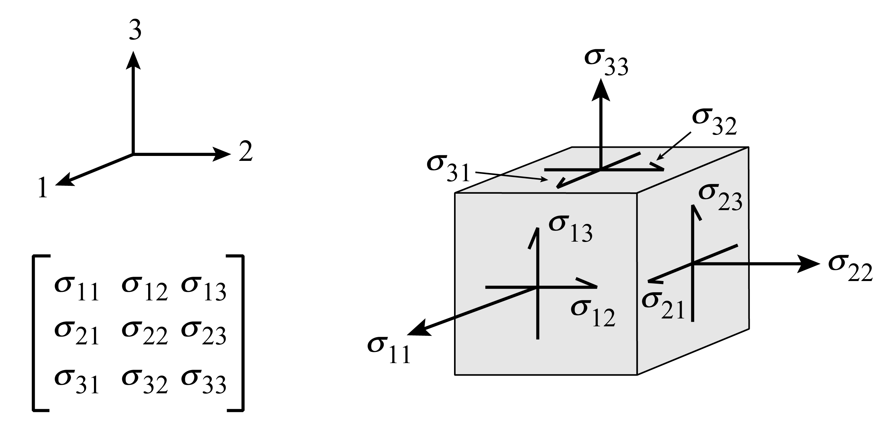
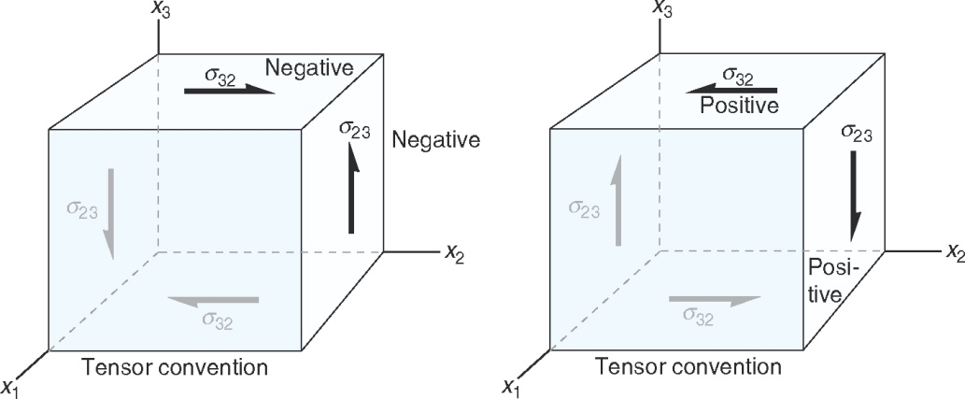
Stress at a point (matrix form)
The nine components of stress may be written as a 3×3 matrix, here shown using the convention of relabelling the x-, y-, and z-axes as 1, 2, and 3 respectively
As in the 2D case, the leading diagonal terms are the normal stresses, and the off-diagonal terms are the shear stresses
The tensor sign convention is again used: the shear stresses are positive if the shear components on the hidden sides of the cube act in positive directions of the coordinate axes (tensor convention)
With this sign convention
σ₁₂ = σ₂₁ ; σ₂₃ = σ₃₂ ; σ₁₃ = σ₃₁
and so the matrix is symmetric about its leading diagonal
Notes:
Figure top by Steve Covey-Crump
Figure bottom from Fossen, p.75

Slide 13
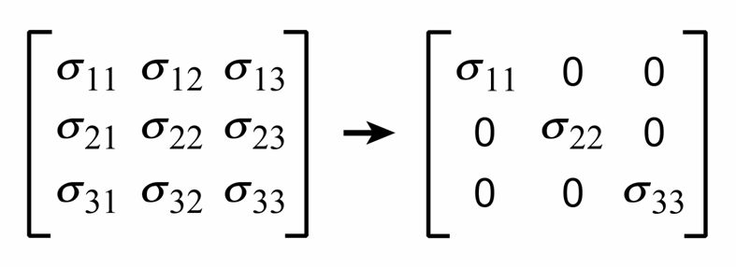
Stress as a tensor
Stress is an example of a tensor quantity. The individual components are defined in a coordinate frame that has a particular orientation; if that frame is rotated the values of the components change. However, they change in accordance with a specific transformation equation, and so if the values are known in any one coordinate frame, they can be calculated in any other
It is always possible to align the coordinate frame such that all the shear stresses are zero – this corresponds with alignment parallel to the axes of the stress ellipsoid
The only non-zero terms in the stress matrix are then the three normal stresses
These normal stresses are the three principal stresses
σ₁ = σ₁₁ ; σ₂ = σ₂₂ ; σ₃ = σ₃₃
Notes:
We noted previously (Class 3) that strain is a tensor quantity
To use the transformation equation mentioned on this slide requires a familiarity with direction cosines. Many texts describe these (e.g., Nye, 1985, Physical Properties of Crystals: Their Representation by Tensors and Matrices (new edition), Oxford University Press; Newnham, 2005, Properties of Materials: Anisotropy, Symmetry, Structure, Oxford University Press) since they form a first step in the manipulation of all physical quantities that are not scalars or vectors
For those with a little more maths than A level provides (that is, for those of you who have done some elementary matrix algebra), it follows that the magnitude of the three principal stresses are the three eigenvalues of the matrix, and the orientation of these principal stresses are its three eigenvectors. These eigenvalues and eigenvectors may be calculated given the full stress matrix in any one orientation of the coordinate frame (an illustration of this procedure for the 2D case is given in the solution set to one of the exercises in the Stress practical)
Figures by Steve Covey-Crump

Slide 14
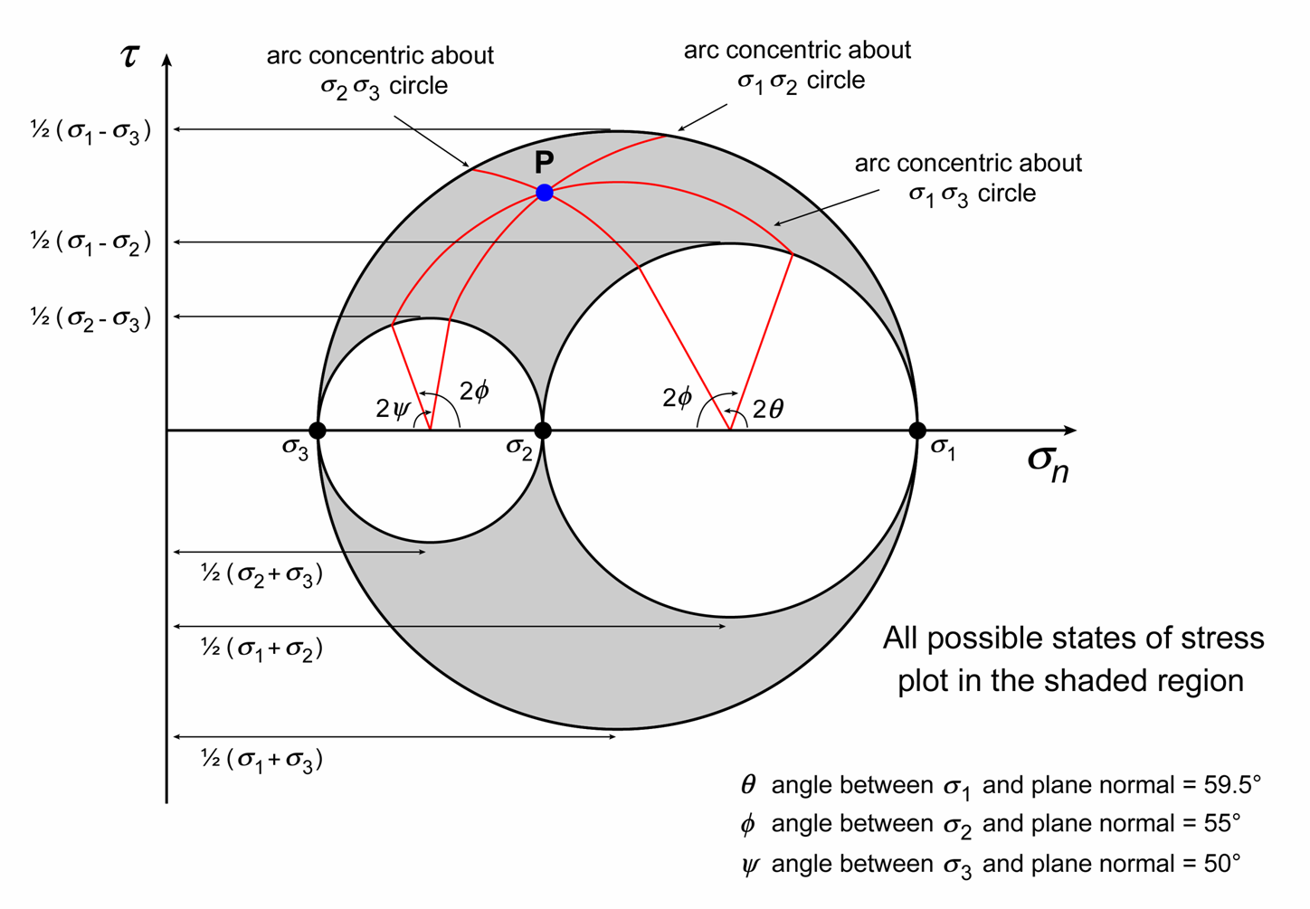
Mohr circle representation of stress (3D)
3D stress states may be shown on a Mohr diagram as a set of nested circles. This is helpful for illustrating particular stress states but when calculating the stress components on differently oriented planes it is simpler to use the stress transformation equation
3d Mohr diagram for a plane, P, with pole oriented at
θ = 59.5°
ϕ = 55°
ψ = 50°
to the σ₁, σ₂, and σ₃ axes respectively
Notes:
For further discussion about using the Mohr diagram for 3D stress, see Jaeger et al. p.27-38 or Twiss & Moores, p.178-181. Careful attention to the signs of shear stresses / angles is necessary (Twiss & Moores, p.178-181, is good at explaining this)
Figure redrawn by Steve Covey-Crump from Allmendinger et al., p.110

Slide 15
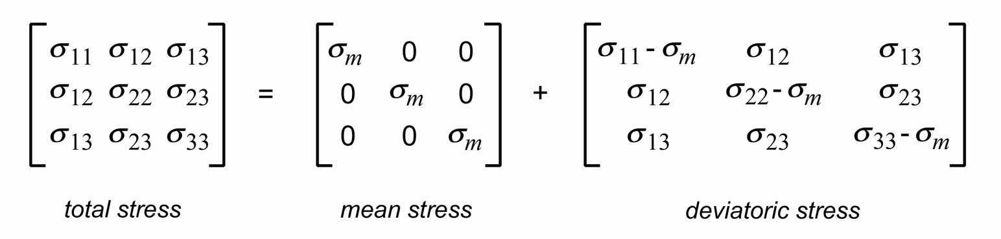
Mean stress, deviatoric stress
Any stress tensor can be split into two matrices in which the first represents the mean stress and the second the deviatoric stress
where σ_{m} = (σ₁₁ + σ₂₂ + σ₃₃) / 3
The mean stress causes/arises from dilation (volume change) while the deviatoric stress causes/arises from distortion (shape change)
In the lithosphere the mean stress is generally similar in magnitude to the confining pressure (which is controlled by burial depth and the density of the overlying rock column). It is usually considerably greater than the deviatoric stress
Nevertheless, it is the deviatoric stress that is of primary interest when considering how geological structures form
Notes:
My “causes/arises from” alternatives are simply different perspectives: one can consider stress as the cause of strain or alternatively one can consider stress as arising as the result of strain (see the points on Slide 39)

Slide 16
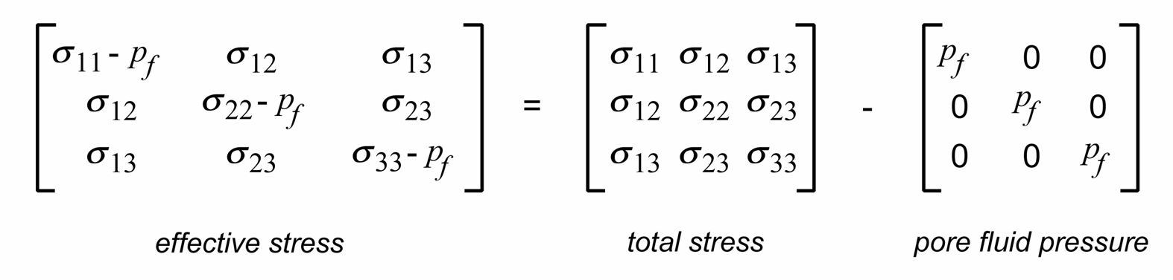
Hydrostatic stress, effective stress
If there is no deviatoric stress (all terms in the deviatoric stress matrix are zero) then it follows that σ₁ = σ₂ = σ₃ and the stress ellipsoid is a sphere. This condition is described as isostatic (or hydrostatic or lithostatic) stress
Pore fluid pressure acts against the normal stresses whilst leaving the shear stresses unaffected. Hence it becomes convenient to define effective stress as
On a Mohr diagram, the effect of pore fluid pressure is to shift the Mohr circle to the left without changing its diameter. The significance of this will be explored in the next two classes
Notes:
Lithostatic tends to be used when referring to stresses in solid rocks, and hydrostatic when referring to stresses in fluids

Slide 17
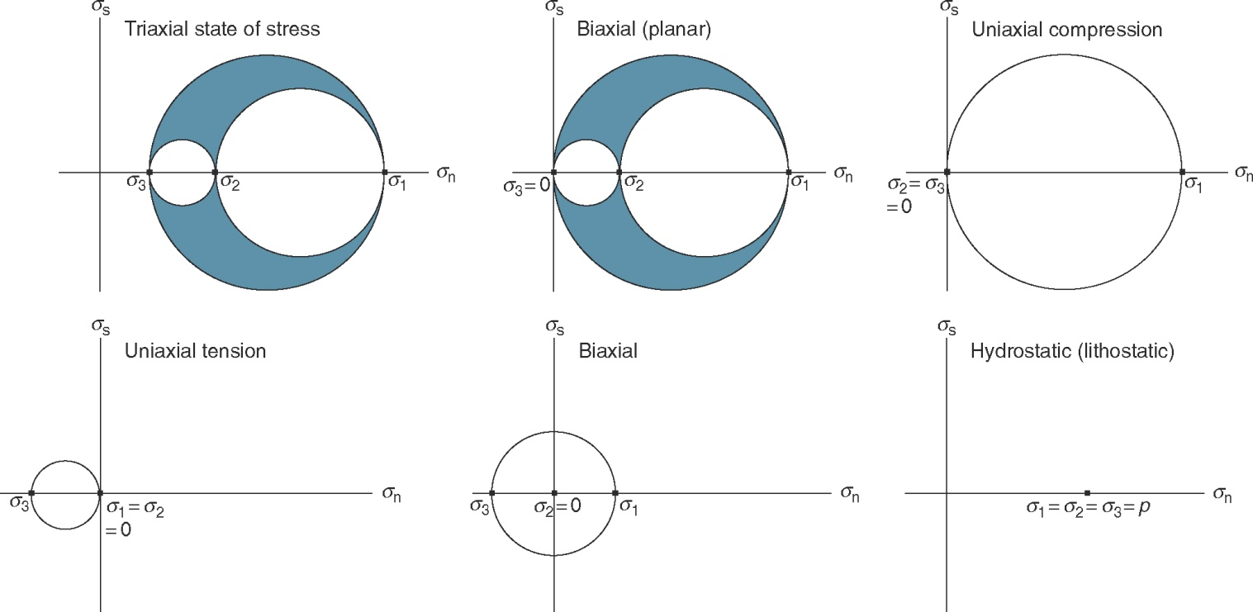
Special states of stress
σ₁ > σ₂ > σ₃ σ₁ > σ₂ > σ₃ = 0 σ₁ > σ₂ = σ₃ = 0
τ
τ
τ
τ
τ
τ
0 = σ₁ = σ₂ > σ₃ σ₁ > σ₂ = 0 > σ₃ σ₁ = σ₂ = σ₃ = p
Notes:
Note that when referring to principal stresses, the double-digit subscript can be specified by one digit (e.g., σ₁ = σ₁₁) without ambiguity
Figure from Fossen, p.80

Slide 18
Measuring stress

Slide 19
Stress measurements
Knowledge of the state of stress in the Earth is important for, e.g.,:
  Safe design of constructions including tunnels, quarries, dams
  Enhancing borehole stability and providing better controls on drill-head steering during well drilling
  Controlled fracture of rocks at depth to enhance oil/gas and geothermal energy production
  Improving our understanding of where and when natural hazards such as earthquakes will occur
  At a fundamental level, improving our understanding of how plate tectonics works
Many of the methods that we use to estimate present-day levels of stress in the Earth have been developed in the engineering, mining, and energy industries, but methods have also been developed by geologists for estimating palaeostress from the microstructures of rocks that have been deformed and then exhumed at the surface
Notes:
For an overview of techniques for measuring present-day stresses, see Ljunggren et al., 2003, International Journal of Rock Mechanics & Mining Sciences 40: 975-989, https://doi.org/10.1016/j.ijrmms.2003.07.003. For borehole stress measurement techniques that are widely used in the petroleum industry, see Zoback et al., 2003, International Journal of Rock Mechanics & Mining Sciences 40: 1049-1079, https://doi.org/10.1016/j.ijrmms.2003.07.001; or Zoback, 2007, Reservoir Geomechanics, p.167-265

Slide 20
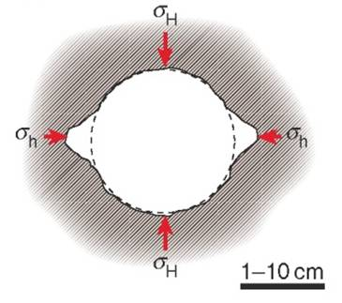
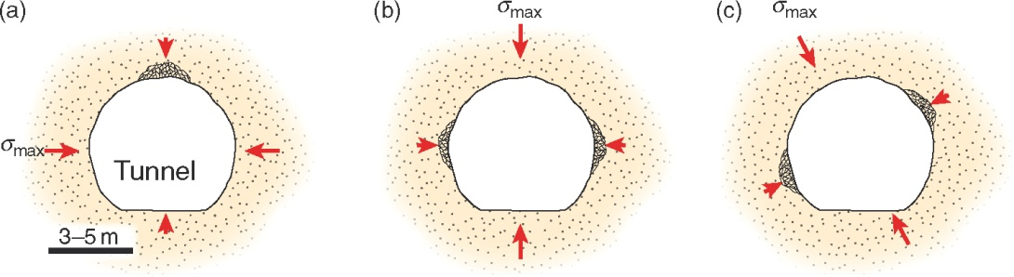
Stress measurements: borehole breakouts
Borehole breakouts are zones of failure in the wall of a borehole – these give the borehole an irregular, typically elongate, shape
The spalling of fragments occurs preferentially parallel to the minimum horizontal stress (σ_{h}), orthogonal to the maximum horizontal stress (σ_{H})
The shape and orientation of the hole is assessed using a dipmeter and a well imaging tool which has arms that can be pressed outwards against the walls as the tool is moved along the borehole
The shape of holes drilled for road or tunnel blasting may also be used in this way, albeit less reliably
Notes:
Borehole breakouts occur parallel to the minimum horizontal stress (σ_{h}) because, assuming that the vertical stress is the greatest principal stress, this is the direction in which the deviatoric stress is greatest – the breakout results from compressive failure of the borehole wall. If the compressive failure strength of the rock is known, the width of the breakout zone may be used to quantify the magnitude of σ_{H} (see Zoback et al., 2003, International Journal of Rock Mechanics & Mining Sciences 40: 1049-1079, https://doi.org/10.1016/j.ijrmms.2003.07.001; or Zoback, 2007, Reservoir Geomechanics, p.196-198)
Figures from Fossen, p.84-85

Slide 21
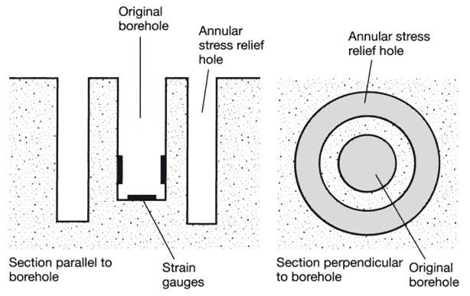
Stress measurements: overcoring
Overcoring is a strain relaxation method
A hole is drilled in the rock and strain gauges attached to the surface of the hole
An annulus is then drilled around the hole to leave a hollow cylinder of rock on which the stress from the surrounding rock has been released
The release of stress causes elastic deformation of the cylinder so that its dimensions and its initially circular cross section change
The stress can be calculated from these changes provided that the elastic properties of the rock are known
A similar approach may be taken by extracting a core of rock and measuring its expansion once it is freed from the constraints of the surrounding rock
Such techniques are limited to depths of a few 10s metres and are commonly used in tunnels
Notes:
A strain gauge is a long wire. The electrical resistance of that wire equals the resistivity of the wire material multiplied by (wire length ÷ wire cross-sectional area). The length and cross-sectional area of the wire change as the sample is deformed and so the resistance changes. From a previous calibration of the change in resistance with strain, the strain of the sample may then be inferred by monitoring the change in resistance
Figure from Twiss & Moores, p.235

Slide 22
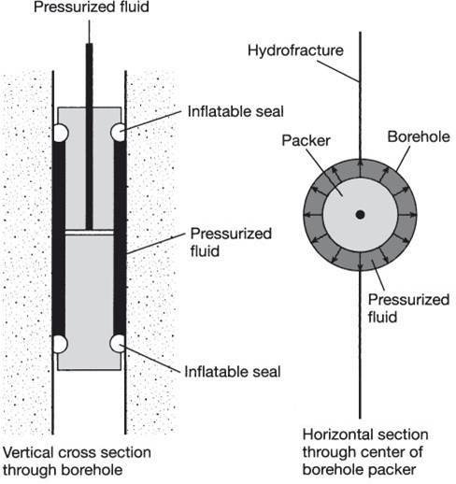
Stress measurements: hydraulic fracturing
Hydrofracking is a technique for establishing the orientation and magnitude of the principal stresses
A section of borehole is sealed off with two inflatable rubber packers and fluid is pumped in to increase the fluid pressure between these two seals
At some critical pressure, an extension fracture forms, and at that moment the fluid pumping system is stopped
The fluid pressure then drops as the fluid flows into the crack until a pressure is reached that is just sufficient to keep the crack open
This latter pressure is taken as σ_{h}, and from this, together with knowledge of the tensile strength of the rock and the critical pressure at which the fracture formed, it is possible to calculate σ_{H}
The fractures form parallel to σ_{H} and so this allows the orientation of σ_{H} to be determined
Notes:
The fractures form parallel to σ_{H} because the hoop stresses (stresses parallel to the circumference of the borehole) are least compressive in this direction and so this is the place where it is easiest to open an extensional fracture
Further details of the calculation of stresses using the hydrofracking technique are given by Twiss & Moores, p.234. For extra information on the subtleties of the technique, see Zoback et al., 2003, International Journal of Rock Mechanics & Mining Sciences 40: 1049-1079, https://doi.org/10.1016/j.ijrmms.2003.07.001; and Couzens-Schultz & Chan, 2010, Journal of Structural Geology 32: 1061-1069, https://doi.org/10.1016/j.jsg.2010.06.013
Figure from Twiss & Moores, p.236

Slide 23
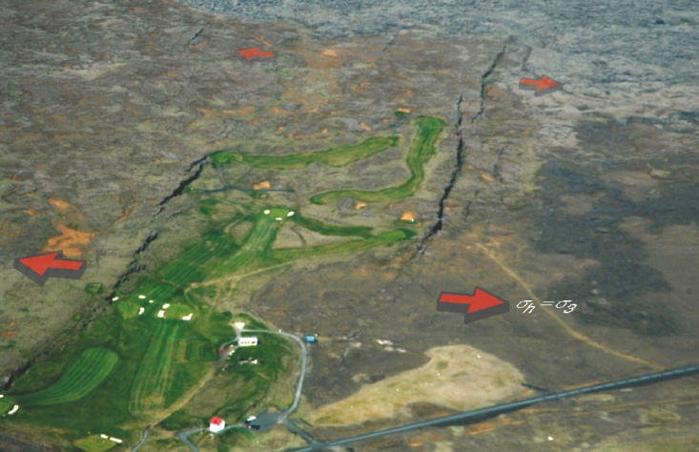
Estimating stress from earthquakes and faults
The orientation of the principal stresses and their relative magnitude as expressed by the stress ratio Φ = (σ₂ - σ₃) / (σ₁ - σ₃) may be estimated from
(a) earthquake first motion studies, or
(b) fault plane and slip vector orientation measurements
In each case, information from several differently oriented faults is needed to constrain the analysis
If (σ₁ - σ₃) and one of the principal stresses (usually the vertical stress) can also be determined, then using Φ the magnitudes of all the principal stresses may be obtained
The orientation and spatial distribution of stylolites, vein systems, and conjugate fractures may all be used to estimate the orientation of the principal stresses, both in currently active tectonic settings at the Earth’s surface, and within the geological record
The analysis of these features forms the core material of the next two classes
Notes:
Methods of determining stresses from fault plane and slip vector measurements are described by Ramsay & Lisle, 2000, The Techniques of Modern Structural Geology, Vol. 3: Applications of Continuum Mechanics in Structural Geology, Academic Press (Session 32). See also Fossen, p.224-230, and Yamaji, 2007, An Introduction to Tectonophysics: Theoretical Aspects of Structural Geology, Chapter 11. For a review and perspective on these methods, see Simón, 2019, Journal of Structural Geology 125: 124-133, https://doi.org/10.1016/j.jsg.2018.02.011
Accompanying this PowerPoint presentation is a folder called “Stresses from Faults” which contains a worked example of how to obtain principal stress orientations from fault plane and slip vector orientations. There is also freely available software that carries out these calculations (e.g., Allmendinger’s FaultKin program: www.geo.cornell.edu/geology/faculty/RWA/programs/faultkin.html, OR https://www.rickallmendinger.net/)
It is often possible to approximate the vertical stress as one of the principal stresses (see Slides 27 and 32). For an example (developed for the calcite twinning case, see next slide) of going from the orientation of principal stresses and the stress ratio to obtaining absolute values of the principal stress magnitudes, see Lacombe, 2007, Journal of Structural Geology 29: 86-99, https://doi.org/10.1016/j.jsg.2006.08.009
Photo (from Fossen, p.86): active vertical fractures on the surface of Holocene lava flows in SE Iceland. Because the fractures occur at the surface, one of the principal stresses must be vertical (see Slide 27)

Slide 24
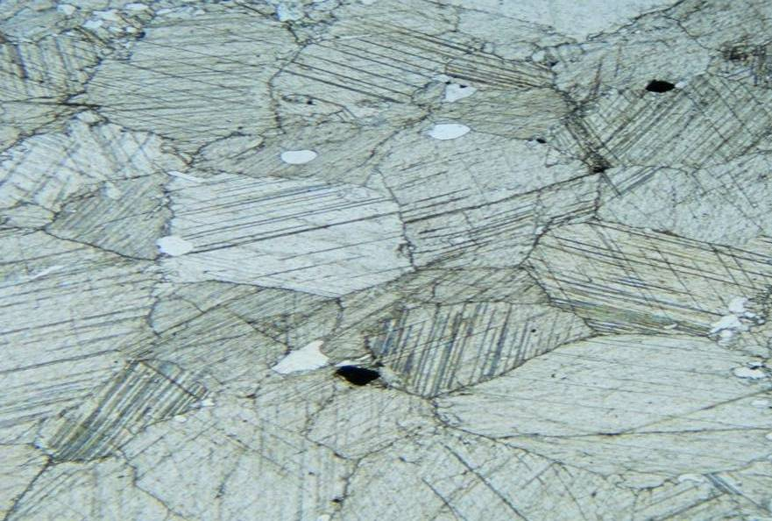
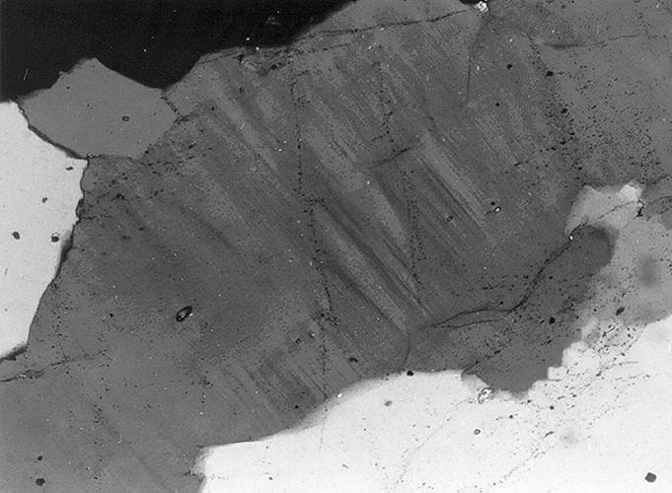
Palaeostress techniques: stress orientations
Principal stress orientations may be estimated from:
  The orientations of mechanical twins
  The orientations of deformation lamellae
Quartz deformation lamellae
Calcite twins
Notes:
The use of palaeostress techniques is to some extent compromised by the need to establish when in the deformation history the microstructures formed
A well illustrated overview of the use of calcite twins for palaeostress determination is given by Lacombe, 2010, Oil & Gas Science and Technology 65: 809-838, https://doi.org/10.2516/ogst/2009088. The use of quartz deformation lamellae is discussed by Twiss & Moores, p.521-524
Accompanying this PowerPoint presentation is a folder called “Stresses from Calcite Twins” which contains a worked example of how to obtain principal stress orientations from calcite twin measurements
Photomicrograph left (from Passchier & Trouw, 2005, Microtectonics (2nd edition), Fig.3.18): quartz deformation lamellae (obliquely inclined in this image), Mt. Isa, Australia
Photomicrograph right (from BGS image database: geoscenic.bgs.ac.uk/asset-bank/action/viewHome, image P531450): calcite twins in a Dalradian limestone, near Kirkton of Glenbucket, Aberdeenshire

Slide 25
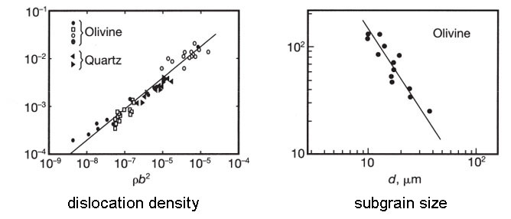
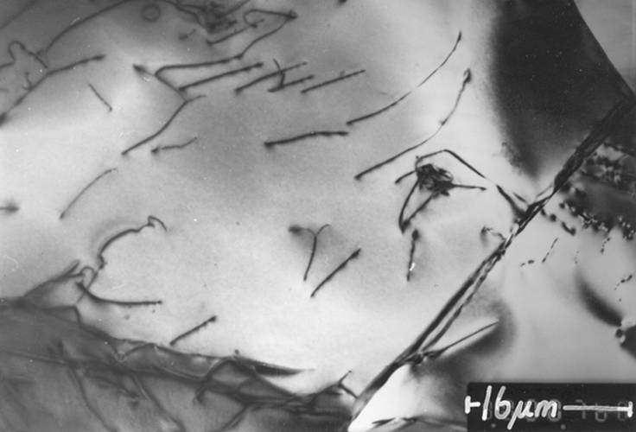
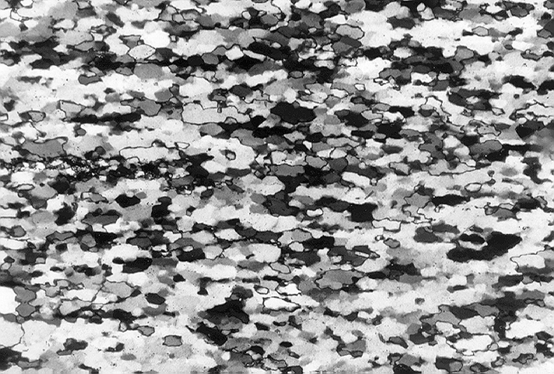
Palaeostress techniques: stress magnitudes
As principal stress magnitude increases:
increased incidence of calcite twinning
increased dislocation density
decreased subgrain diameter
decr. dynamically recrystallized grain size
Some of these piezometers have a strong theoretical foundation and are not merely empirical calibrations from laboratory deformation experiments
(σ₁-σ₃ ) / G
σ₁-σ₃ (MPa)
dislocations in quartz dynamically recrystallized quartz
Notes:
Dislocations are lattice defects (irregularities in the crystal lattice structure). Specifically, they are the edge of an extra half plane of atoms that has been inserted into the crystal lattice. Their generation and motion is a fundamental part of plastic deformation (or more specifically, intracrystalline plasticity) – see the Optional PowerPoint presentation, Slides 24-27
The use of dynamically recrystallized grain size as a piezometer usually requires a knowledge of the recrystallization mechanism (the three mechanisms are noted in the Optional PowerPoint presentation, Slides 32-34)
Figure top right is from Twiss & Moores, p.520. In the dislocation density plot, stress is divided by G (shear modulus) and the dislocation density is multiplied by b² (b = Burgers vector = the slip displacement across a dislocation). Doing this allows data from different minerals (here olivine and quartz) to be shown on the same graph
Image bottom left (from Passchier & Trouw, 2005, Microtectonics (2nd edition), Fig.3.36b): Transmission Electron Microscope image of dislocations (the dark lines) in quartz, quartz ultramylonite, Portugal
Photomicrograph bottom right (from Passchier & Trouw, 2005, Microtectonics (2nd edition), Fig.3.31): dynamically recrystallized quartz, granite mylonite, Qin Ling Mountains, China. Passchier & Trouw indicate that the recrystallization mechanism was subgrain rotation

Slide 26
The state of stress in the lithosphere

Slide 27
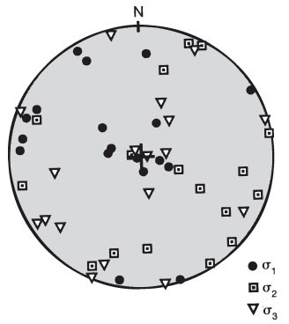
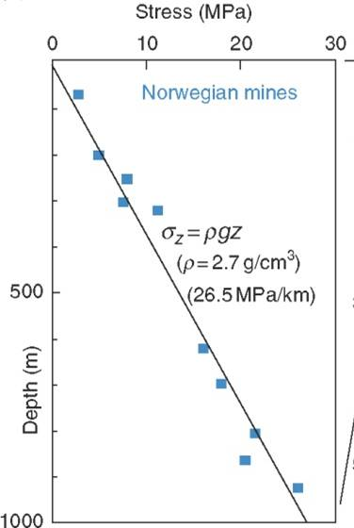
One principal stress is vertical
Rocks at the Earth’s surface are in contact with air or water, neither of which can sustain a shear stress. Hence there is no shear stress at the Earth’s surface and so one of the principal stresses at the Earth’s surface must be vertical and the other two horizontal
Existing data suggests that this is a good approximation throughout the upper crust (that is, to a depth of 15-20 km)
The vertical stress is usually set equal to the overburden given by
σ_{v} = ρ_{rock}gz
where ρ_{rock} is the average density of the rock column to a depth of z below the surface, and g is the acceleration due to gravity
In the continents ρ_{rock} ~2.7 g/cm³, which gives a vertical stress gradient of 26.5 MPa/km. This fits existing data well
Stereogram of the principal stresses in southern Africa. The data are clustered in the centre and spread around the rim → one principal stress is vertical, the other two horizontal
Notes:
“air and water can’t sustain a shear stress”. To be strictly accurate, the shear stresses generated in flowing air or water are miniscule in comparison with tectonically induced shear stresses. Although the shear stresses in flowing air or water are miniscule in comparison with tectonic shear stress, they are important in understanding sediment transport processes
Notice that the σ_{V} = ρgz formula is effectively just a different way of saying F = ma :
vertical stress (σ_{V}) is F/A (where A is cross-sectional area). Density (ρ) = m/V (where V is volume). Acceleration due to gravity (g) = a. Depth (z) = V/A.
So, σ_{V} = ρgz → (F/A) = (m/V) a (V/A) → F = ma
Porous sedimentary rocks have a smaller density (ρ_{rock} = 2.1-2.5 g/cm³)
Figure left (from Twiss & Moores, p.238): note that the clustering of principal stresses in the centre of the stereogram and around the rim implies that one principal stress (which one depends upon the tectonic setting) is vertical and the other two are horizontal
Figure right (from Fossen, p.87) showing stresses measured down to a depth of 1 km in rocks of low or negligible porosity. The vertical stress is well described by the relationship σ_{V} = ρ_{rock}gz with ρ_{rock} = 2.7 g cm⁻³ and g = 9.8 m s⁻²

Slide 28
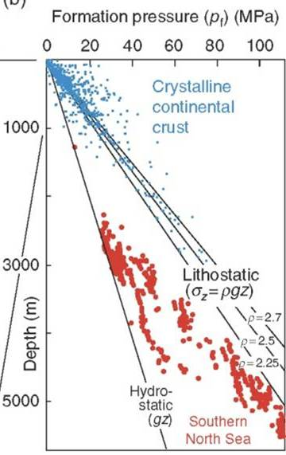
Depth variation of pore fluid pressure
Assuming that pores are interconnected all the way to the surface, the depth variation of pore fluid pressure is
p_{fluid} = ρ_{fluid} g z ~ g z
where ρ_{fluid} is the pore fluid density (~ 1 g/cm³)
If the pores are not interconnected (e.g., a porous sandstone between compacted mudstones), then the pore fluids may be over-pressured
In such cases, pore fluid pressure varies between hydrostatic (above formula) and lithostatic (formula on previous slide) but it cannot be much greater than lithostatic
The pore pressure parameter λ ≡ p_{fluid}/σ_{v}
For pore fluids connected up to the surface
λ = p_{fluid}/σ_{v} = ρ_{fluid}/ρ_{rock} ~ 0.4
so that λ > 0.4 is a measure of over-pressure
Blue data – vertical stress
Red data – pore fluid pressures
Notes:
Note that in using formulae like p = ρgz care is required with units. In SI units we have p as Pa (= N/m²), ρ as kg/m³, g as m/s², and z as m. It is best to work in these units to avoid confusion. However, you will get the same answer for p but in MPa if you use ρ as g/cm³, g as m/s², and z as km. E.g., if ρ = 2.5 g/cm³, g = 10 m/s², and z = 4 km, then p = 100 MPa, or doing it properly with ρ = 2500 kg/m³, g = 10 m/s², and z = 4000 m, then p = 100×10⁶ Pa = 100 MPa
Over-pressured pore fluids are defined as pore fluids with a pore fluid pressure greater than gz. Pore fluid pressure cannot exceed lithostatic pressure (or not by very much) because then the effective pressure would be tensile and rocks are weak in tension – if pore fluid pressure exceeds lithostatic pressure the rock fractures
Over-pressuring is important for borehole engineers because it may mean that the over-pressured rocks are poorly compacted/cemented and hence that the borehole is liable to collapse. Moreover, if a borehole penetrates an over-pressured fluid reservoir, the fluid will erupt to the surface
Figure from Fossen, p.87. Note that the red data show over-pressured pore fluids

Slide 29
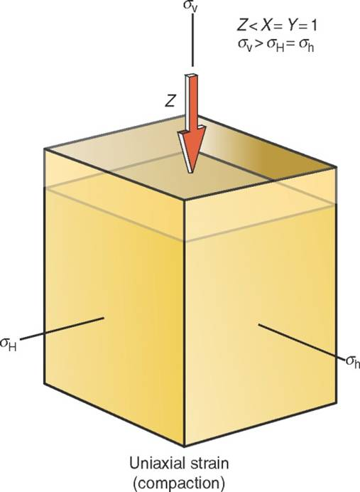
Horizontal stresses: uniaxial strain reference state
Consider a case where there is burial with no lateral strain because the rocks to either side do not allow it (e.g., burial in a sedimentary basin)
The vertical stress (= σ₁) is given by σ_{v} = ρ_{rock} g z and the horizontal stress, σ_{H} = σ_{h} (= σ₂ and σ₃ respectively), by
σ_{H} = [ ν / (1 - ν ) ] σ_{v} = [ ν / (1 - ν ) ] ρ_{rock} g z
where ν is Poisson’s ratio. For rocks 0.25 > ν > 0.33 and so the horizontal stress is expected to be about one half to one third of the vertical stress
The change in horizontal stress during burial and uplift for this uniaxial strain model is
Δσ_{H} = [ ν / (1 - ν ) ] Δσ_{v} + [ E / (1 - ν ) ] α ΔT
where the effect of temperature changes (ΔT ) has been included (E = Young’s modulus; α = thermal expansion coefficient)
Notes:
Reference states are important for defining the state of stress with depth in circumstances where there are no tectonic stresses. They are then the starting point for considering what happens when a tectonic stress is added. The lithostatic depth variation of stress described on the previous two slides is effectively a reference state, although not one that provides a good indication of horizontal stresses
The uniaxial reference state equation on this slide is one that is widely employed to constrain the magnitude of the horizontal stresses for elastically isotropic materials. It is straightforwardly derived (from the equations for elastic deformation - see Optional PowerPoint presentation Slides 10-11) if one recalls that the strain in given direction (here the H direction) comprises three components: the strain produced by the stress in that direction ( ε_{H1} = σ_{H} / E ) less the expansion arising from the Poisson effect induced by the stresses applied in the other two orthogonal directions ( ε_{H2} = -νε_{V} = -νσ_{V} /E and ε_{H3} = -νσ_{h} /E ), where E is the Young’s modulus of the rock and ν is Poisson’s ratio of the rock. Hence
ε_{H} = ε_{H1} + ε_{H2} + ε_{H3} = (σ_{H} /E ) - (νσ_{V} /E ) - (νσ_{h} /E ) = (1/E )[σ_{H} - ν(σ_{V} + σ_{h})]
If we require that ε_{H} = 0 (no strain in the H direction) then
0 = (1/E )[σ_{H} - ν(σ_{V} + σ_{h})]
Since (1/E ) is not zero,
0 = [σ_{H} - ν(σ_{V} + σ_{h})]
Letting σ_{h} = σ_{H} (because in the uniaxial reference state the stress is the same in all horizontal directions) and rearranging
0 = σ_{H} - ν(σ_{V} + σ_{H}) → σ_{H} - νσ_{H} = νσ_{V} → σ_{H} = [ ν / (1 - ν) ] σ_{V}
For the inclusion of the temperature term in the above derivation, see Haxby & Turcotte, 1976, Geology 4: 181-184, https://doi.org/10.1130/0091-7613(1976)4<181:SIBTAO>2.0.CO;2
The figure is from Fossen, p.89

Slide 30
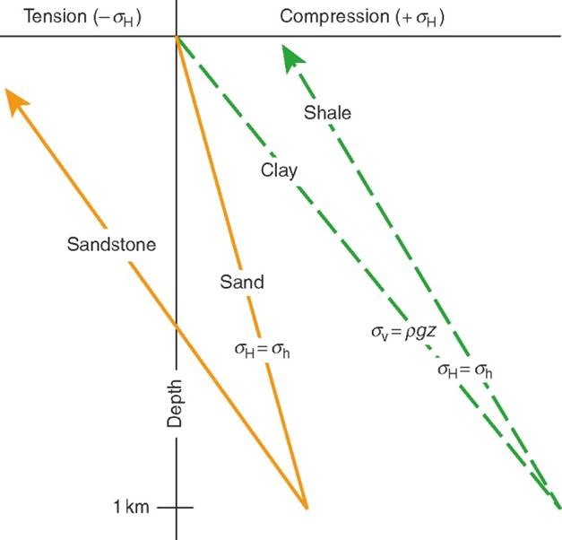
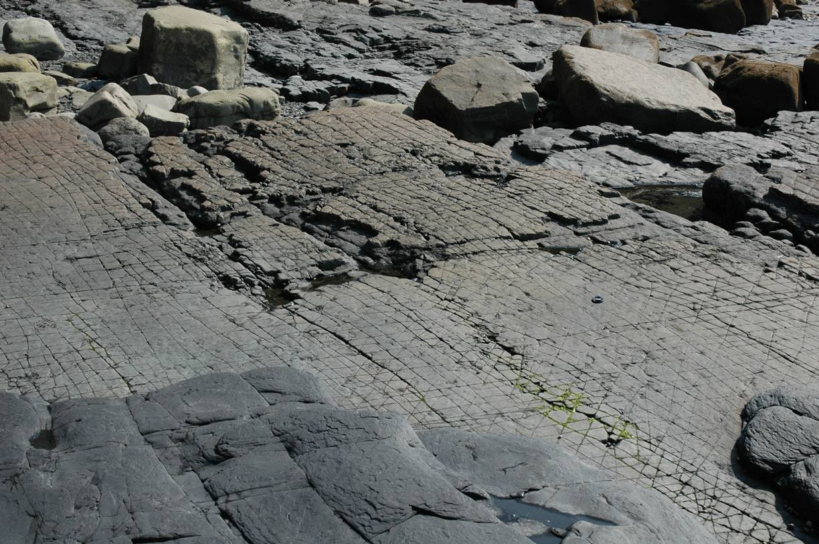
Horizontal stresses: uniaxial strain reference state 2
Depending upon their ν, E and α, adjacent lithologies will have different stress histories
σ_{H} = [ ν / (1 - ν ) ] σ_{v}
If during burial ν_{sands} = 0.25 and ν_{muds} = 0.40 then σ_{H, sands} = 0.5σ_{H, muds} ; if after lithification at depth both lithologies have ν ~ 0.3, then when they are brought back to the surface, the sandstones will be in tension and the mudstones in compression
Right: fracture sets in sandstone units but not within mudstone interbeds – Amroth
Notes:
Note that this analysis assumes the uniaxial strain reference state, that is, it is only applicable when there is no lateral strain. The model incorporates a crude account of the variation of elastic properties with depth (that is, the variation of ν and implicitly, E – see notes to previous slide), it neglects pore pressure effects, and it assumes that lithification occurs instantaneously at maximum burial depth so that there is one set of elastic properties for burial and one set for uplift. These simplifications mean that the model has illustrative value only. For further discussion about the model, see Engelder, 1985, Journal of Structural Geology 7: 459-476, https://doi.org/10.1016/0191-8141(85)90049-5
Figure from Fossen, p.92
Photo right (Steve Covey-Crump): fractures in sandstone units within the Bishopston Mudstone Formation of late Marsdenian/early Yeadonian age, Telpyn Point, Amroth, Pembrokeshire. Could these be fractures formed as the horizontal stresses became tensional in the sandstones during uplift and exhumation?

Slide 31
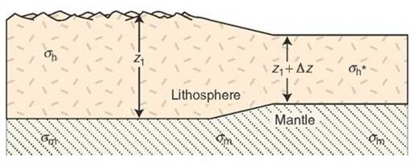
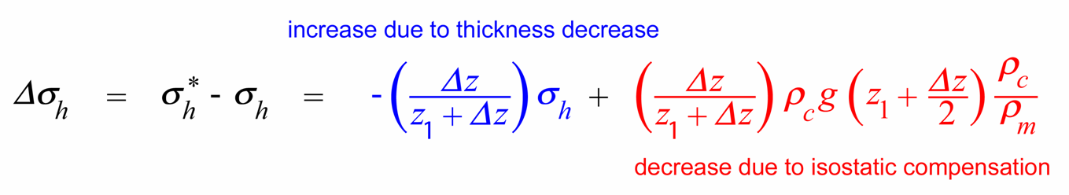
Constant remote horizontal stresses
Consider an isostatically compensated lithosphere of thickness z₁. Below this depth the mantle behaves like a fluid, that is, σ_{H} = σ_{h} = σ_{v}
If we change the thickness of the lithosphere by erosion (thinning) or
by sedimentation (thickening), isostatic readjustment raises the base of the lithosphere (erosion case) or lowers it (sedimentation case)
If at great distance the horizontal stress remains constant, then locally the horizontal stress must be greater in the thinner section of lithosphere than in the thicker section because the horizontal forces are being applied over a smaller area
One may show that
Δz = change in thickness, thinning is - ve; ρ_{c} = lithosphere density; ρ_{m} = mantle density
Difference in horizontal stress
This expression is the most realistic available for a lithosphere unaffected by tectonic forces
Notes:
The derivation (which is straightforward) of the equation shown on this slide for the constant horizontal stress reference state is given by McGarr, 1988, Journal of Geophysical Research 93: 13609-13617, https://doi.org/10.1029/JB093iB11p13609. Note that the horizontal stress in the thinned lithosphere is greater because the horizontal forces are acting over a smaller area (the area over which the horizontal stresses act is given by the thickness of the crust, which is now smaller, times the length in the third dimension into and out of the plane of the figure on this slide, which we hold constant)
Figure (modified by Steve Covey-Crump from Fossen, p.90) showing the terms used in the constant horizontal stress reference state. Note that σ_{h}* is the horizontal stress in the lithosphere in the part that has been thinned (or thickened) relative to the part that is of reference thickness

Slide 32
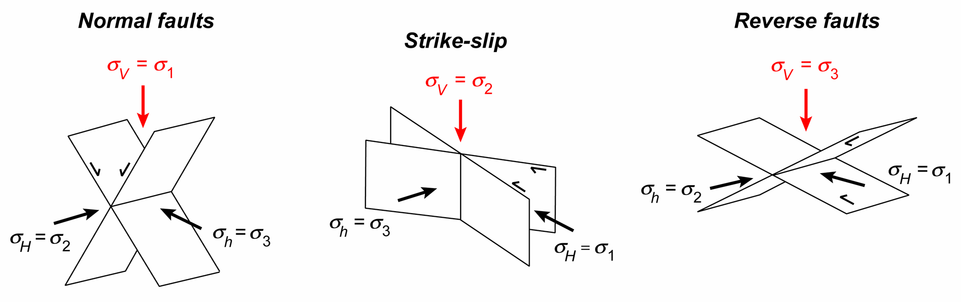
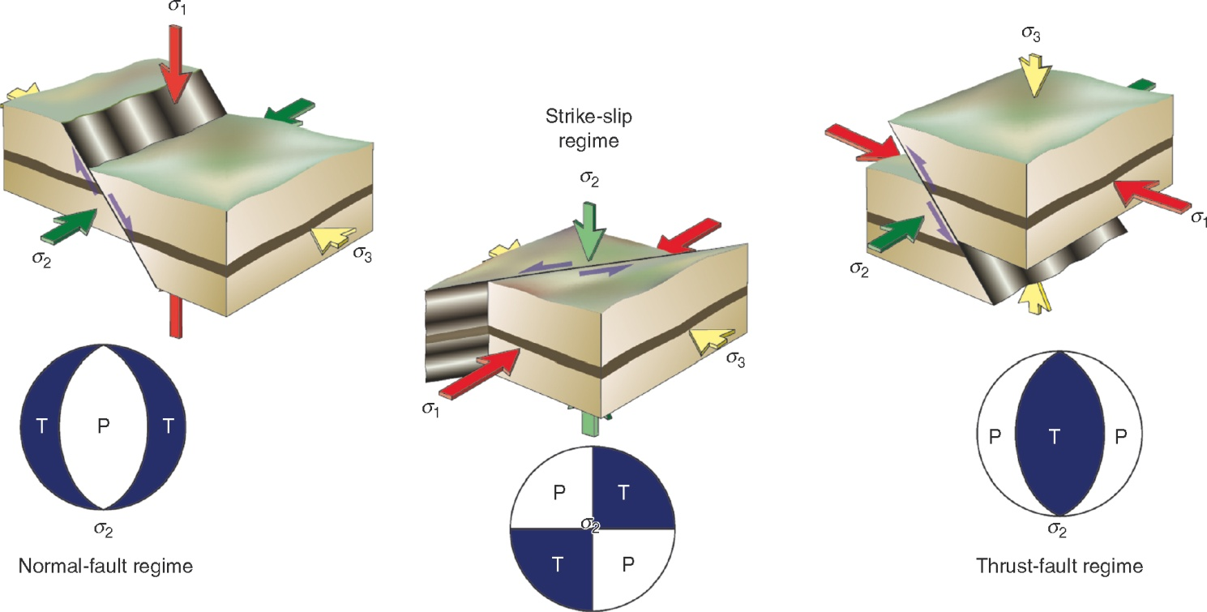
Tectonic stresses
Deviations from the states of stress that we have discussed so far arise predominantly from tectonic processes
Tectonic stresses are classified into three regimes depending upon which of the three principal stresses is vertical (Andersonian classification)
Notes:
Anderson noted that there are three possible arrangements of principal stresses when one is assumed to be vertical (no shear stress parallel to Earth’s surface), and so there are three possible arrangements of fault geometry with respect to these stress orientations if we assume that conjugate faults form (at ± 30° to σ₁) with σ₂ lying in the plane of each fault (parallel to their line of intersection). Anderson outlined his scheme in Anderson, 1905, Transactions of the Edinburgh Geological Society 8: 387-402, https://doi.org/10.1144/transed.8.3.387. See also Anderson, 1951, The Dynamics of Faulting and Dyke Formation With Application to Britain (2nd edition). The classification has since been developed to accommodate situations of transtension and transpression (see Simpson, 1997, Journal of Geophysical Research 102: 17909-17919, https://doi.org/10.1029/97JB01274)
It should be noted that the assumption that σ₂ lies in the fault plane is an oversimplification and cannot be true in the case where three or more differently oriented faults that do not share a common line of intersection are simultaneously active. Hence, although the Andersonian scheme is extremely widely used, it does have limitations (for further discussion on this point, see Healy et al., 2015, Journal of Structural Geology 80: 57-71, https://doi.org/10.1016/j.jsg.2015.08.013)
Figure top by Steve Covey-Crump
Three figures bottom from Fossen, p.93

Slide 33
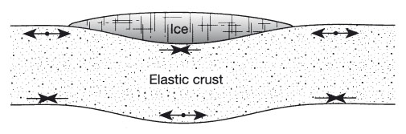
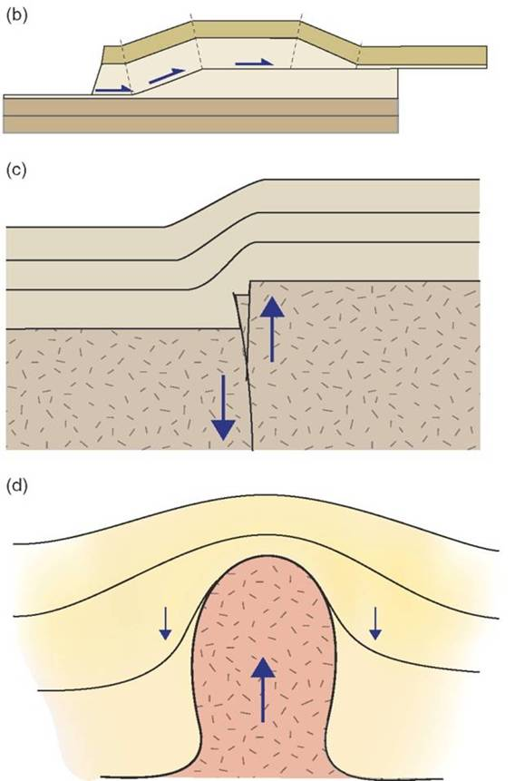
Other sources of stress: stresses due to bending
Bending of the lithosphere generates stresses over distances comparable with the wavelength of the bending. Plates bend . . .
at subduction zones where they enter the trench
in response to surface loading
  ice sheets
  accumulations of volcanic rocks
  sediment loading in sedimentary basins and unloading through erosion
  thrust sheets
in response to movement across latitudes (because the Earth is not a perfect sphere)
More locally, bending occurs adjacent to other structures such as faults and folds, and diapiric intrusions
Notes:
Figure top from Twiss & Moores, p.237. Note that by replacing the ice with lava flows, the figure is a cartoon of the deformation of the lunar crust under the lunar mare
Figure bottom from Fossen, p.269

Slide 34
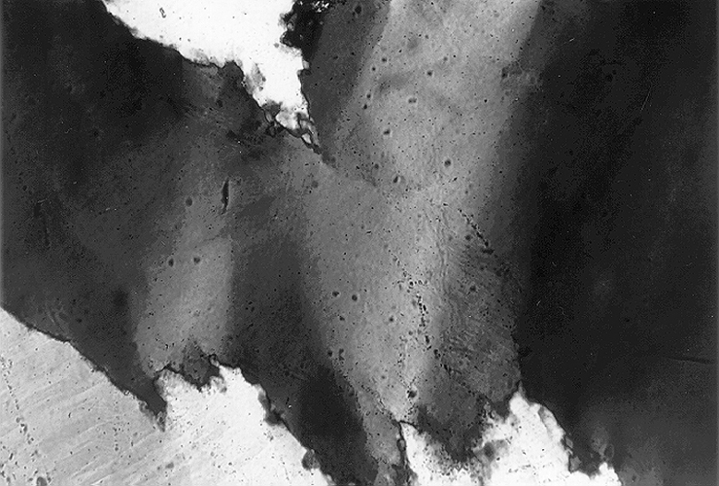
Other sources of stress: residual stress
There are microscale ways in which stresses may be induced in rocks, including:
Changes in temperature: differences in thermal expansion between two minerals in a rock induce thermal stresses during heating or cooling
Changes in pressure: differences in compressibility between minerals induce stresses during pressurization/depressurization
Deformation itself generates lattice defects (e.g., dislocations) which induce stresses within the lattice that remain after the deformation has ceased
Crystallization of a melt sets up stresses
Metamorphic reactions with a volume change induce stresses
Stresses of these kind are stored within the rock as residual stresses that may be relieved during uplift and erosion by fracturing
Notes:
Photomicrograph (from Passchier & Trouw, 2005, Microtectonics (2nd edition), Fig.3.31): undulose extinction within quartz in a micaschist from the Orobic Alps, Italy. Undulose extinction results from a strained lattice and hence implies the presence of stored stresses. Note that in the grain in the bottom left corner there are some deformation lamellae

Slide 35
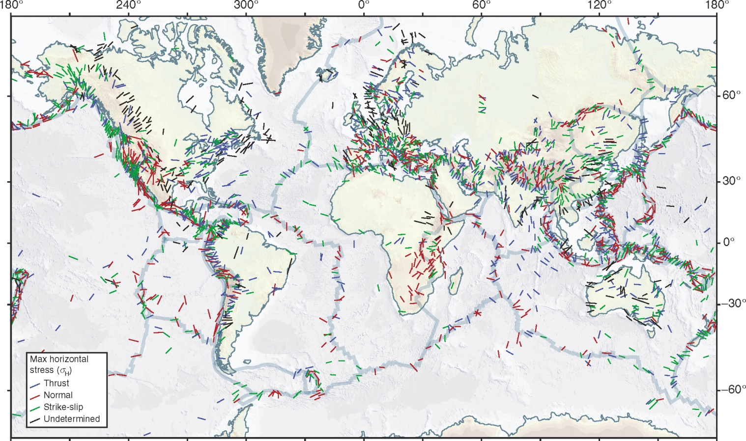
World stress map
Stress measurements from around the world have been evaluated, compiled and made available by the World Stress Map project
Notes:
The World Stress Map is described by Heidbach et al., 2018, Tectonophysics 744: 484-498, https://doi.org/10.1016/j.tecto.2018.07.007. It is available on-line at www.world-stress-map.org. You can use the site to create your own stress maps for regions that you define
Note the use of the Andersonian tectonic stress regimes (see Slide 32)
Figure from Fossen, p.95

Slide 36
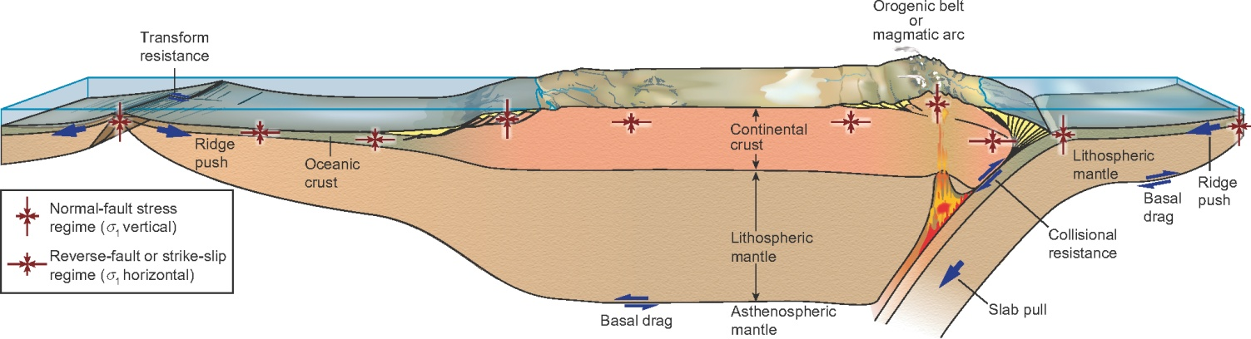
Stresses within a plate tectonic context
The output from the World Stress Map may be readily correlated with the principal forces arising from plate tectonics, namely, slab pull, ridge push, collisional resistance, and basal drag
These forces define a global stress pattern that is locally modified by gravity-controlled second-order sources of stress, that is, stresses arising from the processes leading to bending that were identified on Slide 33
Notes:
Figure from Fossen, p.95

Slide 37
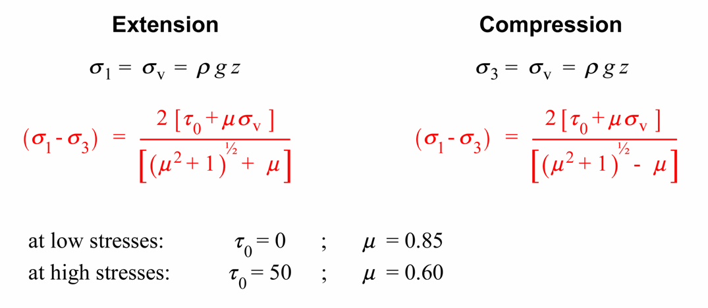
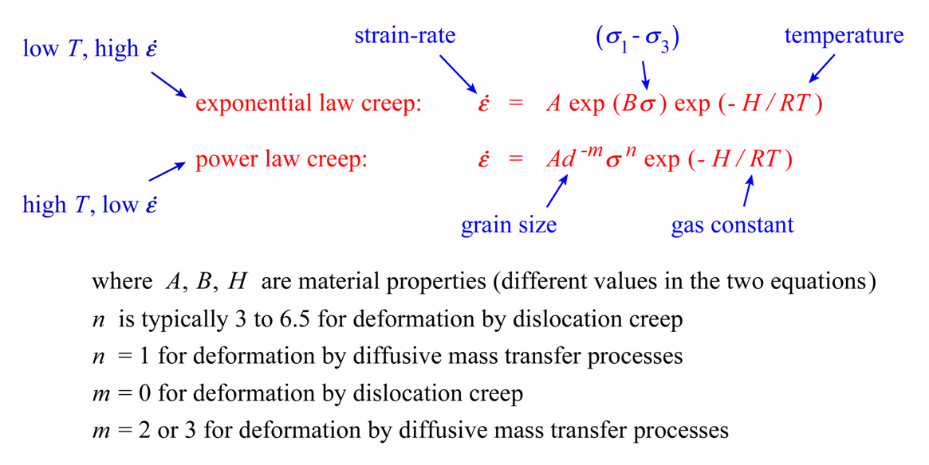
A word on lithospheric strength
The stress at any given depth is commonly approximated as the strength of the rocks at that depth. This is given by constitutive equations that combine material specific parameters with the important deformation variables (temperature, stress, strain-rate)
cataclastic deformation
Intracrystalline plasticity and diffusive mass transfer
The four most widely used constitutive equations for specifying rock strength: at any depth, the one that gives the smallest (σ₁ - σ₃) applies
Notes:
The notion that the stress in the lithosphere equals the strength of the rocks under the conditions (temperature, pressure, strain-rate, etc. – see Optional PowerPoint presentation Slide 6) that they experience, is captured by saying that the lithosphere is ‘critically stressed’. For a development of such ideas, see Zoback & Townend, 2001, Tectonophysics 336: 19-30, https://doi.org/10.1016/S0040-1951(01)00091-9; and Zoback et al., 2002, International Geology Review 44: 383-401, https://doi.org/10.2747/0020-6814.44.5.383
The meaning of the terms ‘cataclastic’, ‘intracrystalline plasticity’, and ‘diffusive mass transfer’ are given in the Optional PowerPoint presentation. You don’t need to worry about these terms in this unit – they just refer to different ways in which the rock responds to stress. Near the surface of the Earth where the rocks are relatively cool and where pressures (from the weight of overlying rock) are small, rocks tend to be brittle (fail by fracturing = cataclastic deformation); deeper where the rocks are hotter and at higher pressure, they flow without forming fractures – intracrystalline plasticity and high temperature diffusive mass transfer are two groups of processes by which they do this
Note that the four equations on this slide are gross simplifications of real material strength but, nevertheless, they are widely regarded as useful first order approximations. The equations for cataclastic deformation – really just one equation rewritten for σ₁ vertical (extension) and for σ₃ vertical (compression) – are essentially independent of rock type. This independence of rock type is known as Byerlee’s law, and we will return to it in Class 7. The equations for intracrystalline plasticity and diffusive mass transfer do not include a variable that accounts for the mechanical condition of the deforming material and so are described as steady state creep laws

Slide 38
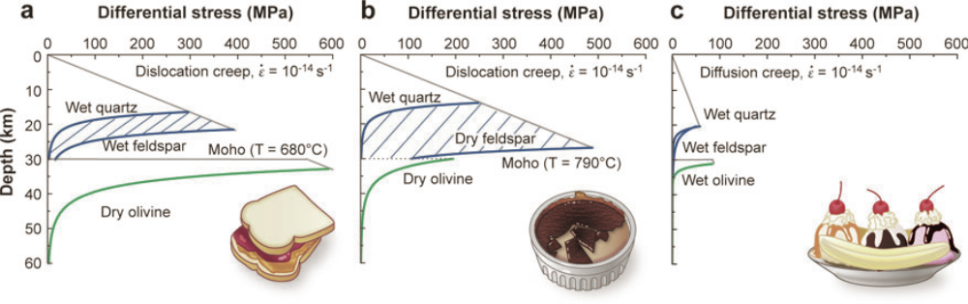
A word on lithospheric strength 2
Plots of strength vs. depth are calculated for given strain-rate, geothermal gradient, and lithological stratification
For a continental lithosphere (upper crust = quartz, lower crust = feldspar, upper mantle = olivine), various models of strength with depth are in wide currency:
  ‘Jelly sandwich’: weak lower crust between strong upper crust and upper mantle thought to apply to relatively cool geothermal gradients and a hydrated lower crust
  ‘Crème brûlée’: strong crust and weak mantle thought to apply to relatively high geothermal gradients and dehydrated lower crust
  A third ‘Banana split’ model is applied to long established, major fault zones that extend to great depth
The oceanic lithosphere with its thin doleritic crust overlying an olivine-dominated upper mantle, has a better understood strength vs. depth profile
Notes:
The underlying principles and data used to construct lithospheric strength vs. depth profiles are summarized by Kohlstedt et al., 1995, Journal of Geophysical Research 100: 17587-17602, https://doi.org/10.1029/95JB01460
For colourful (and culinary) discussions on the strength vs. depth profile of the continental lithosphere, see
Jackson, 2002, GSA Today 12(9): 4-10, https://doi.org/10.1130/1052-5173(2002)012<0004:SOTCLT>2.0.CO;2
Burov & Watts, 2006, GSA Today 16(1): 4-10, https://doi.org/10.1130/1052-5173(2006)016<4:TLTSOC>2.0.CO;2
Thatcher & Pollitz, 2008, GSA Today 18(4-5): 4-11, https://doi.org/10.1130/GSAT01804-5A.1
Bürgmann & Dresen, 2008, Annual Reviews in Earth and Planetary Science 36: 531-567, https://doi.org/10.1146/annurev.earth.36.031207.124326
As an example of where this type of thinking can lead when considering the variation of lithospheric strength with depth, see Behr & Platt, 2014, Geophysical Research Letters 41: 8067-8075, https://doi.org/10.1002/2014GL061349
Figure from Bürgmann & Dresen, 2008, Annual Reviews in Earth and Planetary Science 36: 531-567, https://doi.org/10.1146/annurev.earth.36.031207.124326

Slide 39
Stress or strain?
Throughout this presentation the material has been presented as if stress is the cause of deformation. This is not always appropriate
The cause of a mechanical process is determined by boundary conditions, that is, by the conditions that are externally imposed on a body
  If stresses are imposed and maintained on the boundaries then stress is the cause of the deformation and strain is the response to it
  If, however, the boundaries are required to move by a prescribed amount or at a prescribed rate, then strain is the cause of the process and stresses develop in response to it (e.g., the uniaxial strain reference state)
Many of our measurements in structural geology are actually of strain rather than stress and so care needs to be taken when inferring stresses from those data, particularly when the strains involved are finite rather than infinitesimal
Notes:
The uniaxial strain reference state (Slide 29) is built on the notion that the horizontal stresses arise because there is no strain in the horizontal direction – the stresses arise from the imposed zero horizontal strain
When we look at geological structures, we are looking at strains not stresses. Hence drawing stress directions on maps from observations of geological structures is a risky business – we are implicitly making an interpretation of how the stresses arise from the strains. We shall see in the next couple of lectures that the temptation to do this is considerable – that doesn’t make it wrong, but we do need to acknowledge what we are doing
A discussion of this matter, as applied to the extraction of the orientations and relative magnitudes of the principal stresses from fault slip data, is given by Twiss & Unruh, 1998, Journal of Geophysical Research 103: 12205-12222, https://doi.org/10.1029/98JB00612

Slide 40
Reading
Fossen H (2016) Structural Geology (2nd edition). Cambridge University Press. [Chapters 4, 5]
Twiss RJ, Moores EM (2007) Structural Geology (2nd edition). WH Freeman and Co. [Chapters 7, 9]
Gudmundsson A (2011) Rock Fractures in Geological Processes. Cambridge University Press. [Chapter 2; some good worked examples involving the use of Mohr’s circles]
Other excellent texts covering the same territory in different ways
Turcotte DL, Schubert G (2002) Geodynamics (2nd edition). Cambridge University Press. [Chapter 2]
Price NJ, Cosgrove JW (1990) Analysis of Geological Structures. Cambridge University Press. [p.1-7]
Ragan DM (2009) Structural Geology: An Introduction to Geometrical Techniques (4th edition). Cambridge University Press. [Chapter 9]
Pollard DD, Fletcher RC (2005) Fundamentals of Structural Geology . Cambridge University Press. [Chapter 6]
Allmendinger RW, Cardozo N, Fisher DM (2012) Structural Geology Algorithms: Vectors and Tensors. Cambridge University Press. [Chapter 6]
Jaeger JC, Cook NGW, Zimmerman RW (2007) Fundamentals of Rock Mechanics (4th edition). Blackwell Publishing. [Chapter 2]

